Slide 1



QUIZIZ
-A new platform to learn

Slide 2

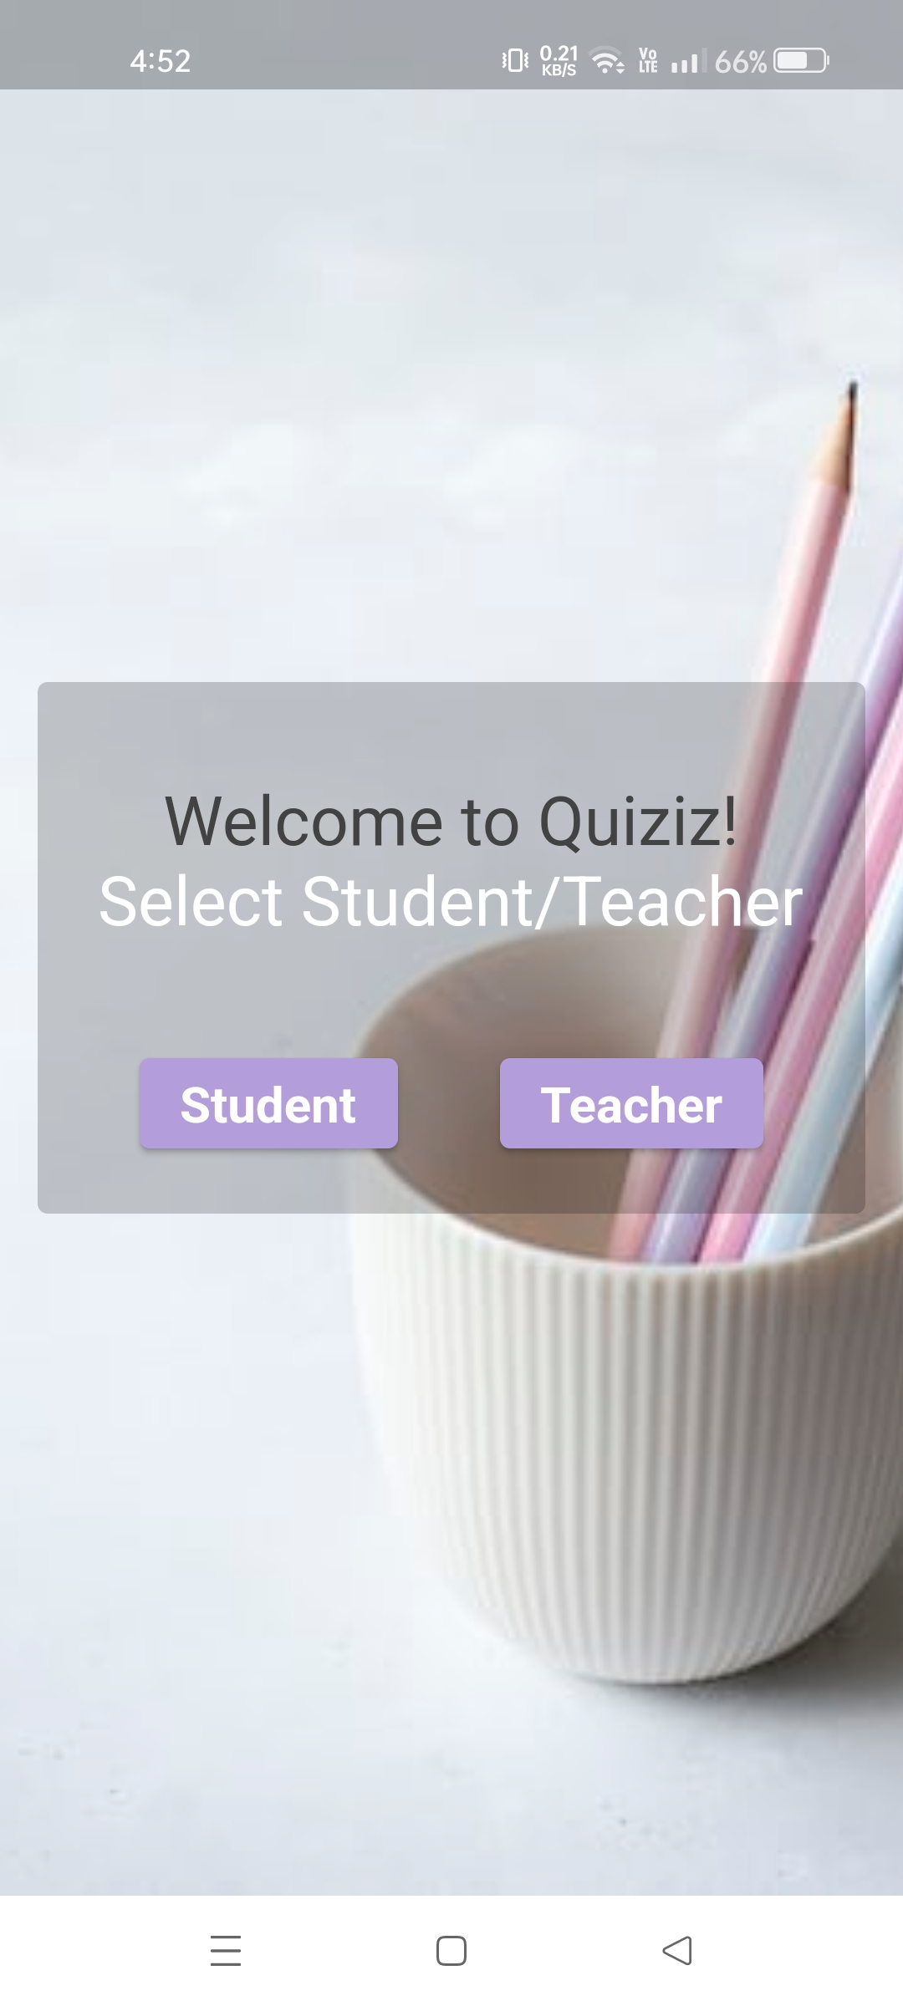
Start page
Initially, when we open the app it shows two options Student/Teacher.
On selecting the required buttons directs us to the corresponding Sign-in pages.

Slide 3

TEACHER

Slide 4
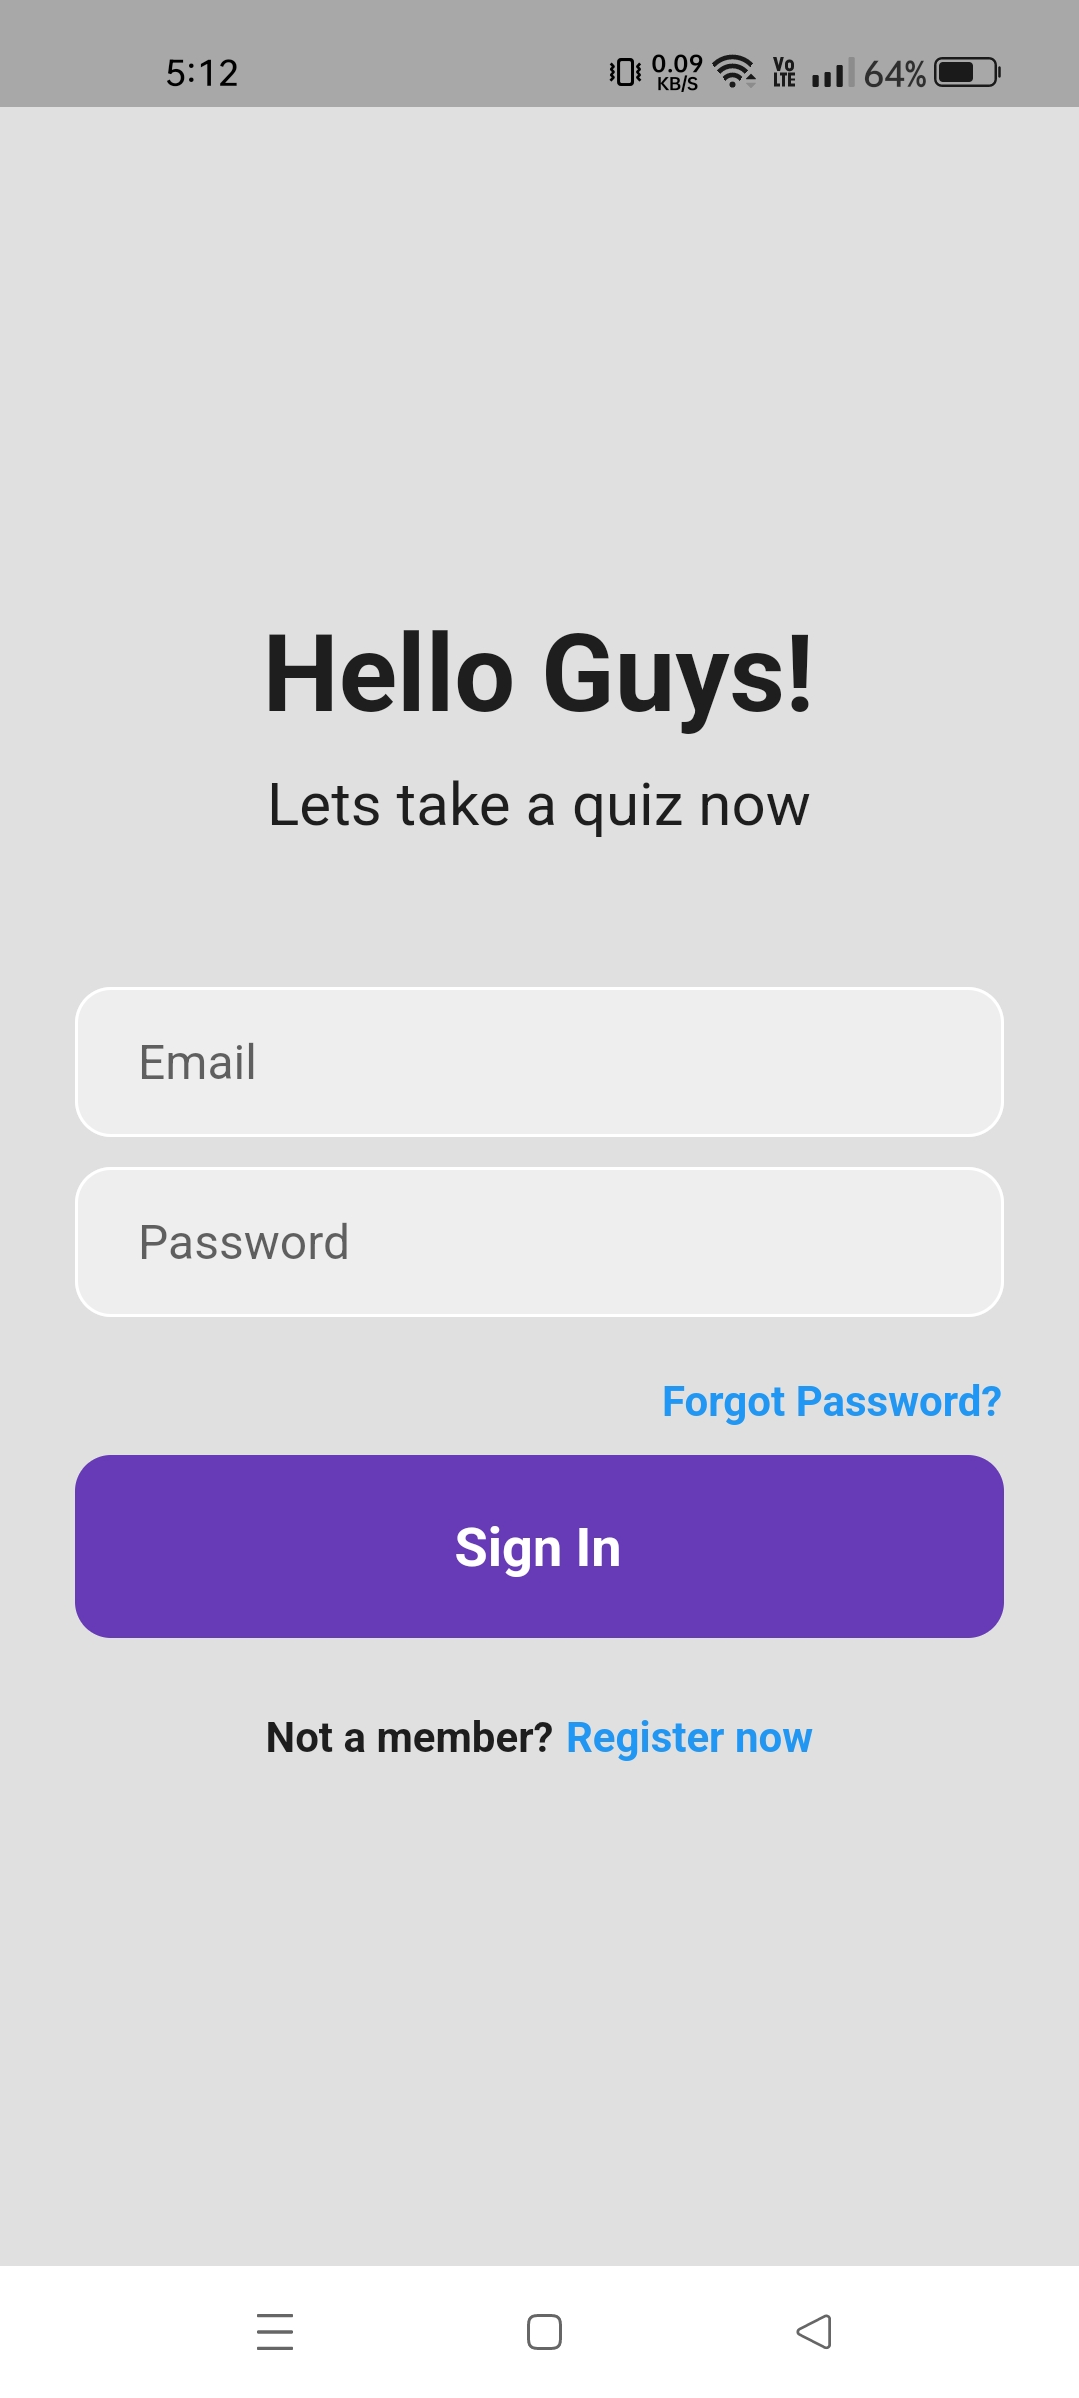
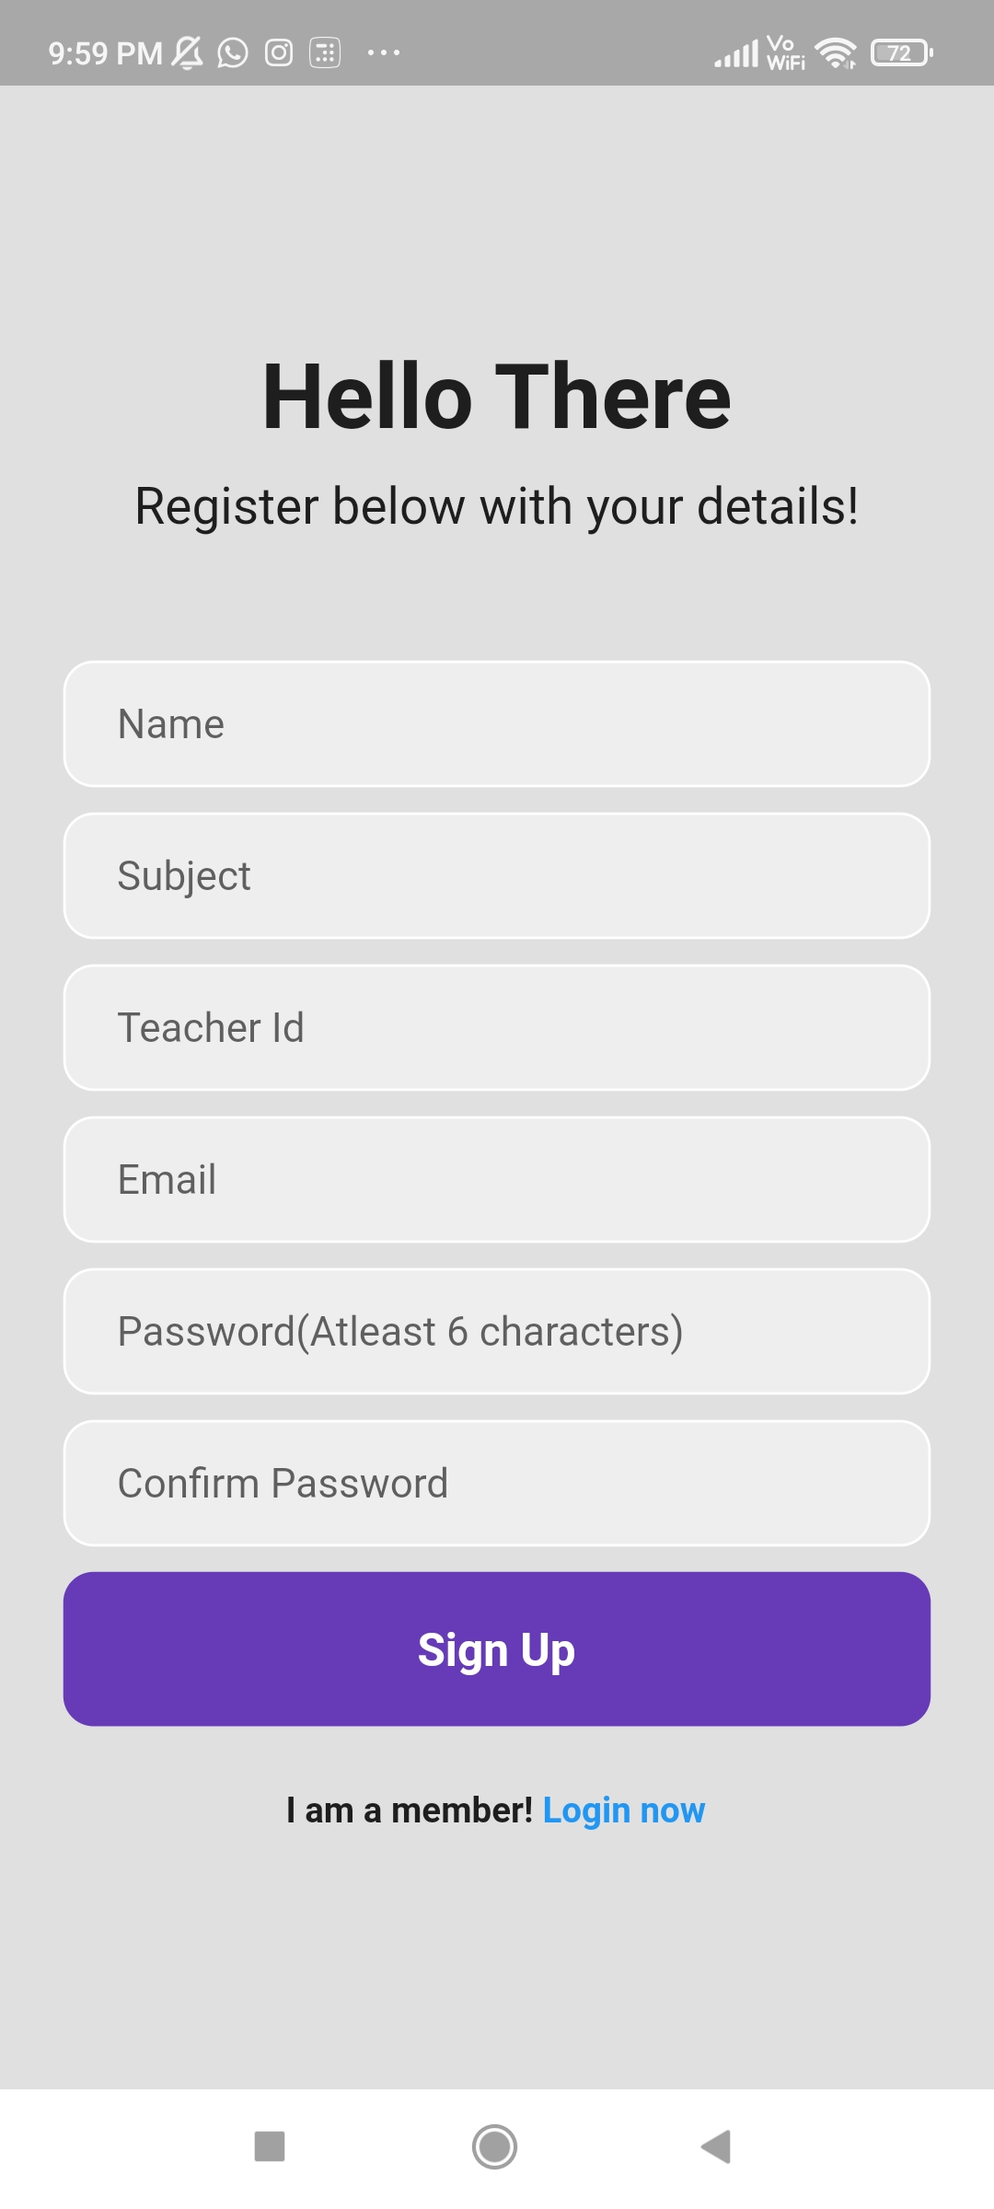
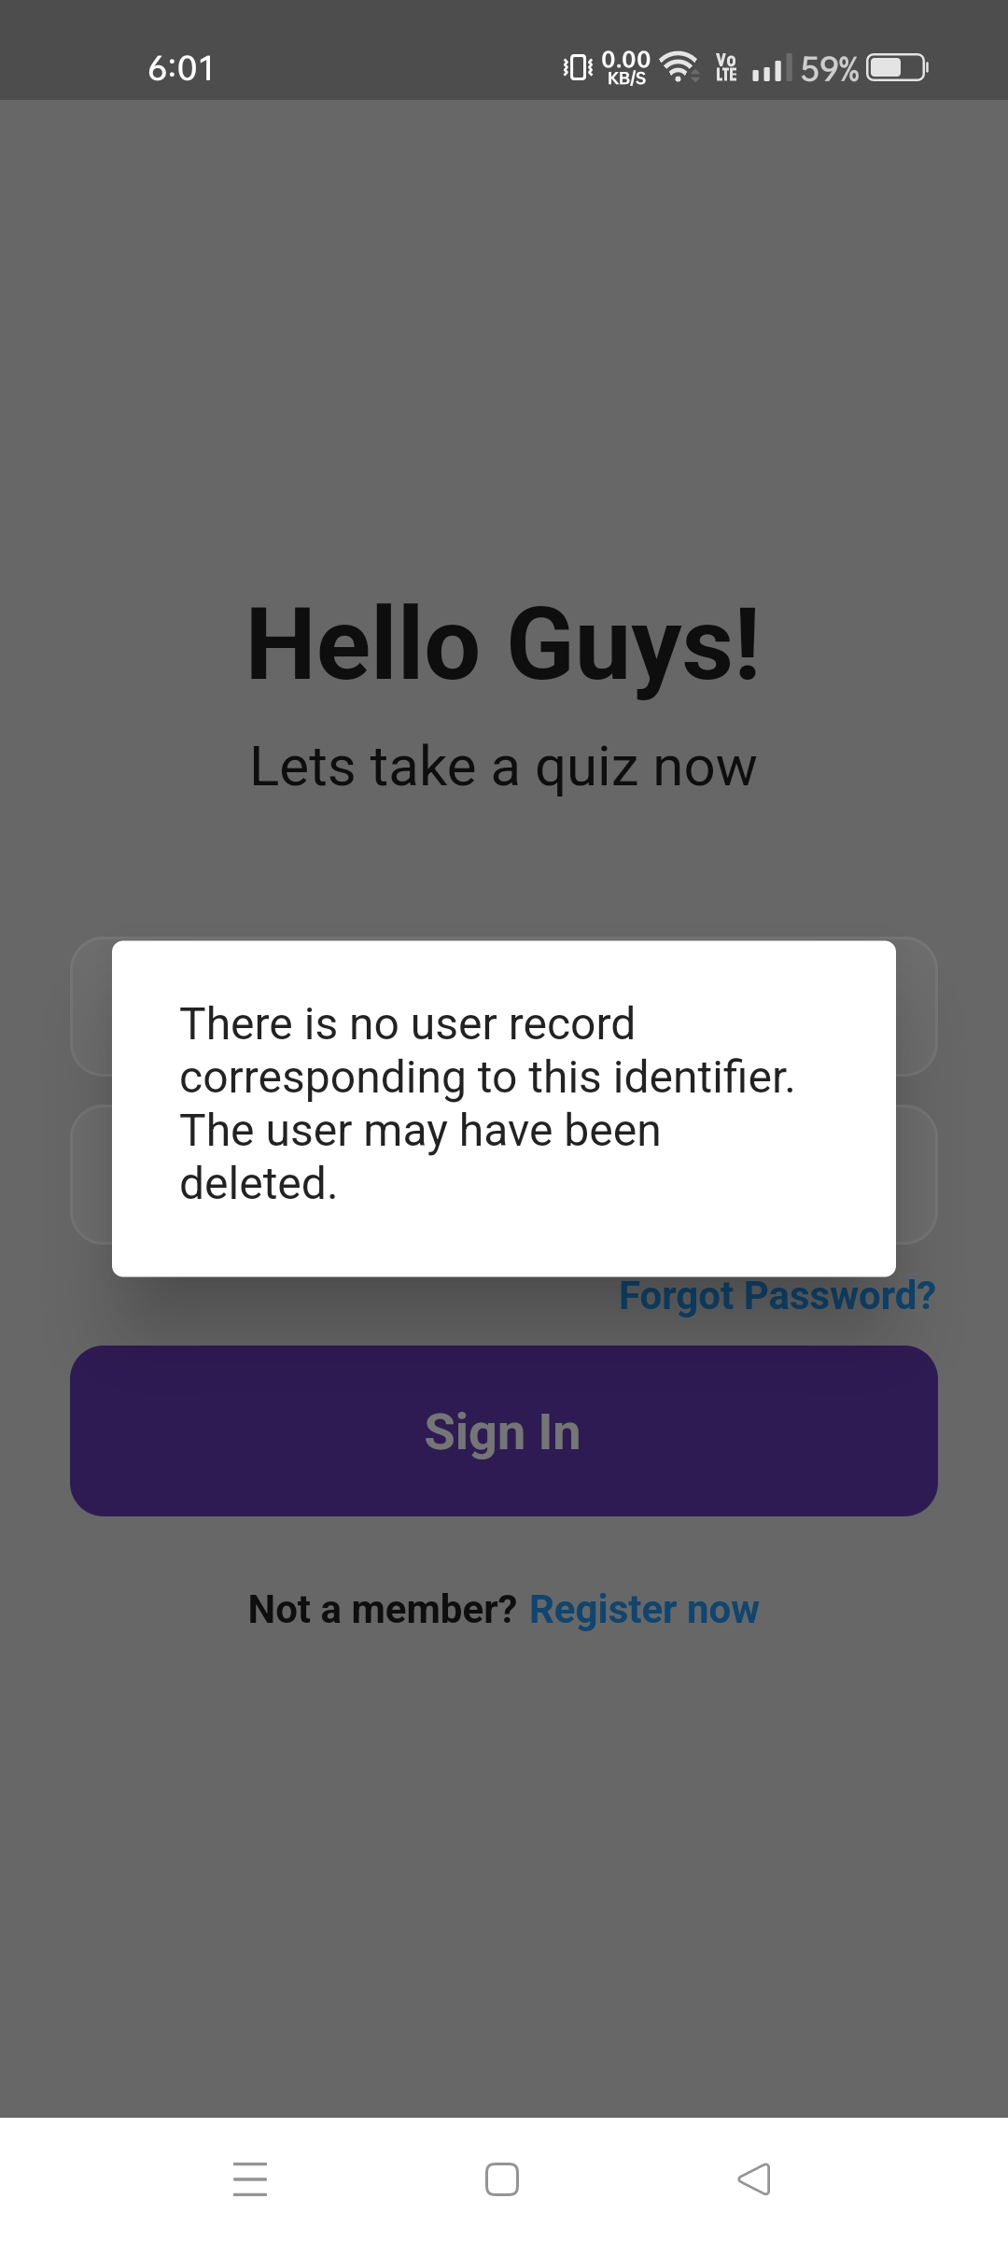
TEACHER SIGN-IN PAGE
In the SIGN-IN PAGE Teacher need to enter his/her registered details.
If not registered then they need to click the “Register now” button which takes them to the Register page where they have to enter their details and click Sign-up.
NOTE: If student enter non-registered mail then we get this error message.

Slide 5
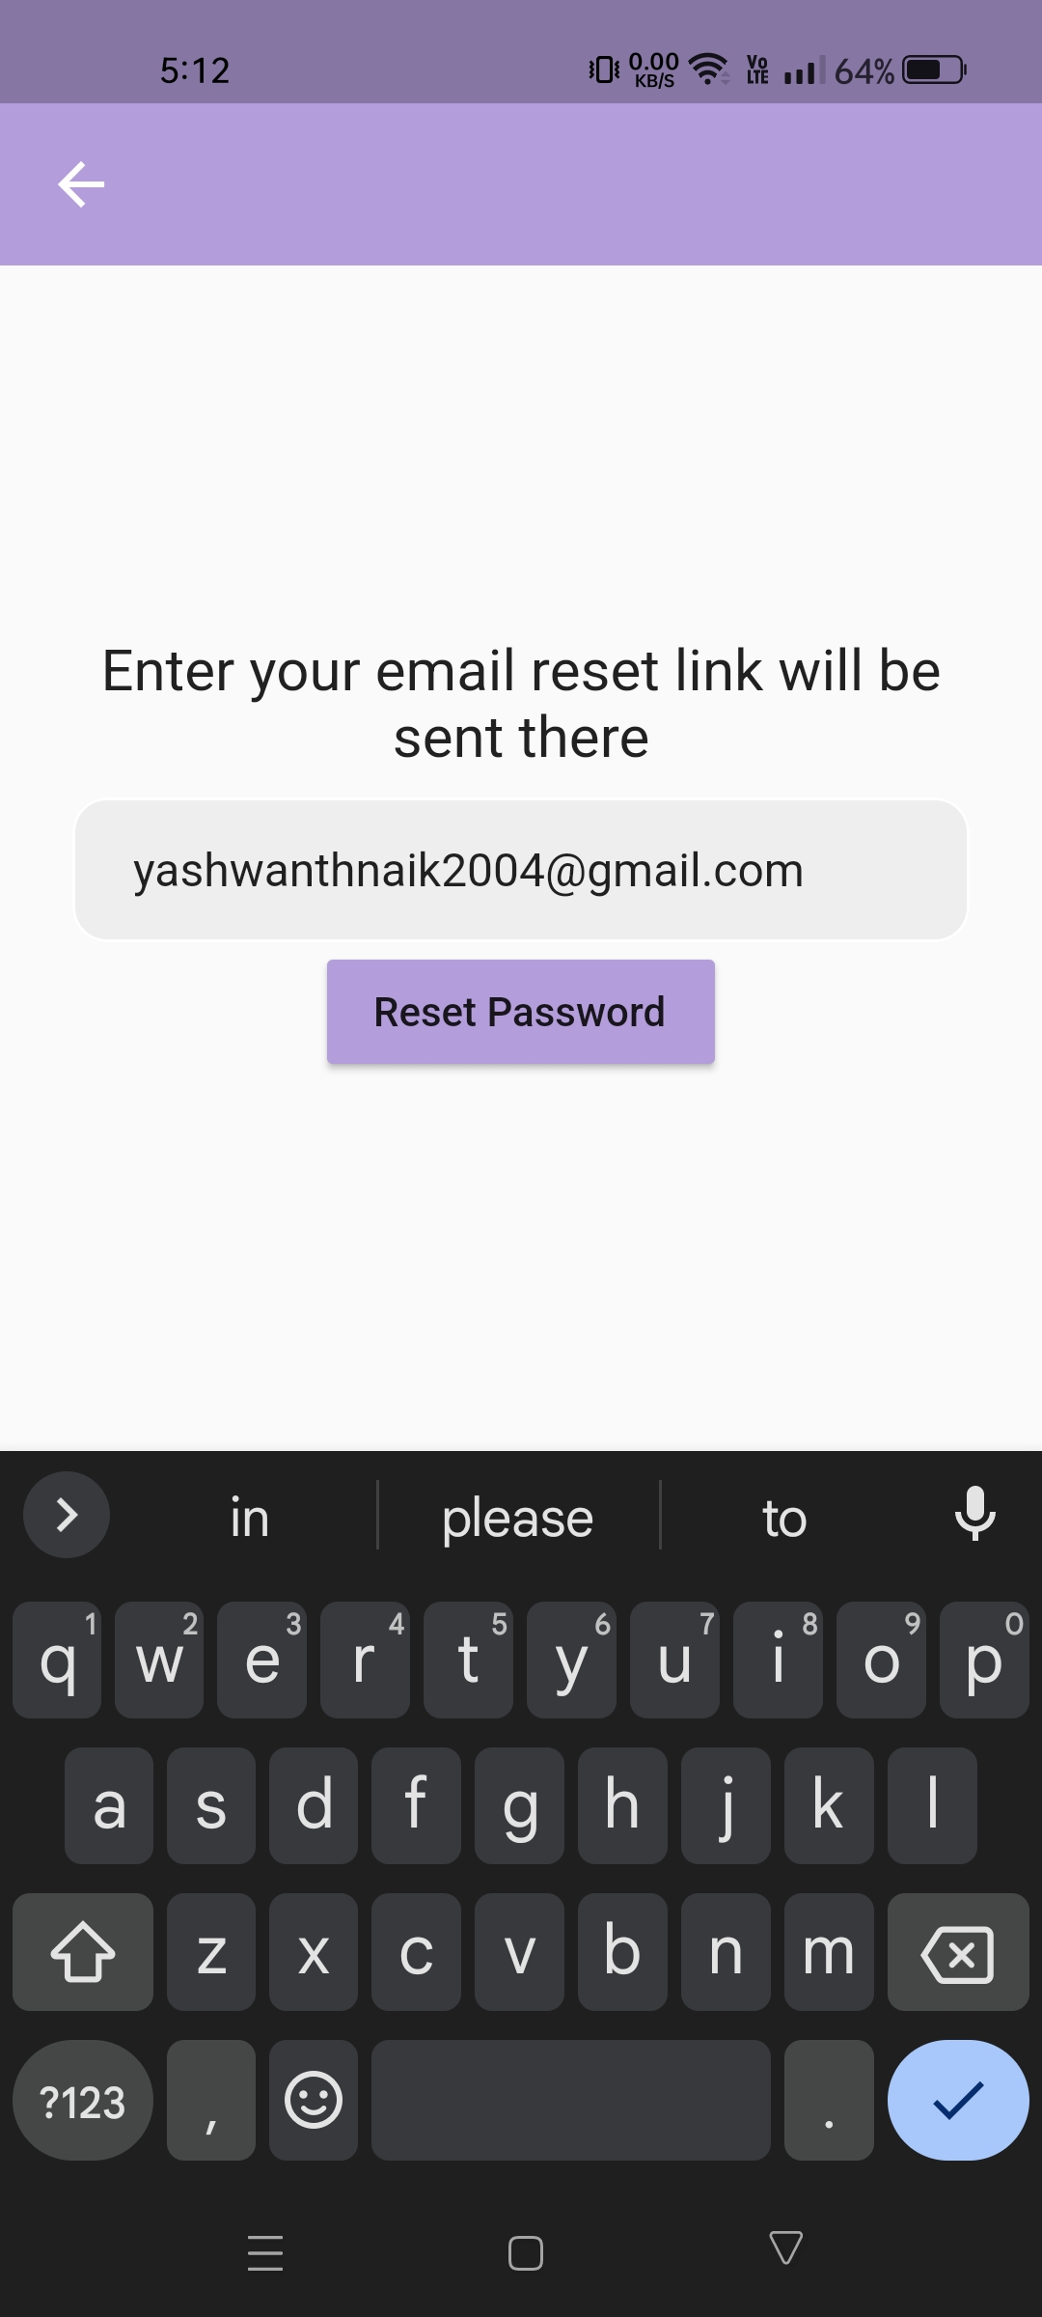
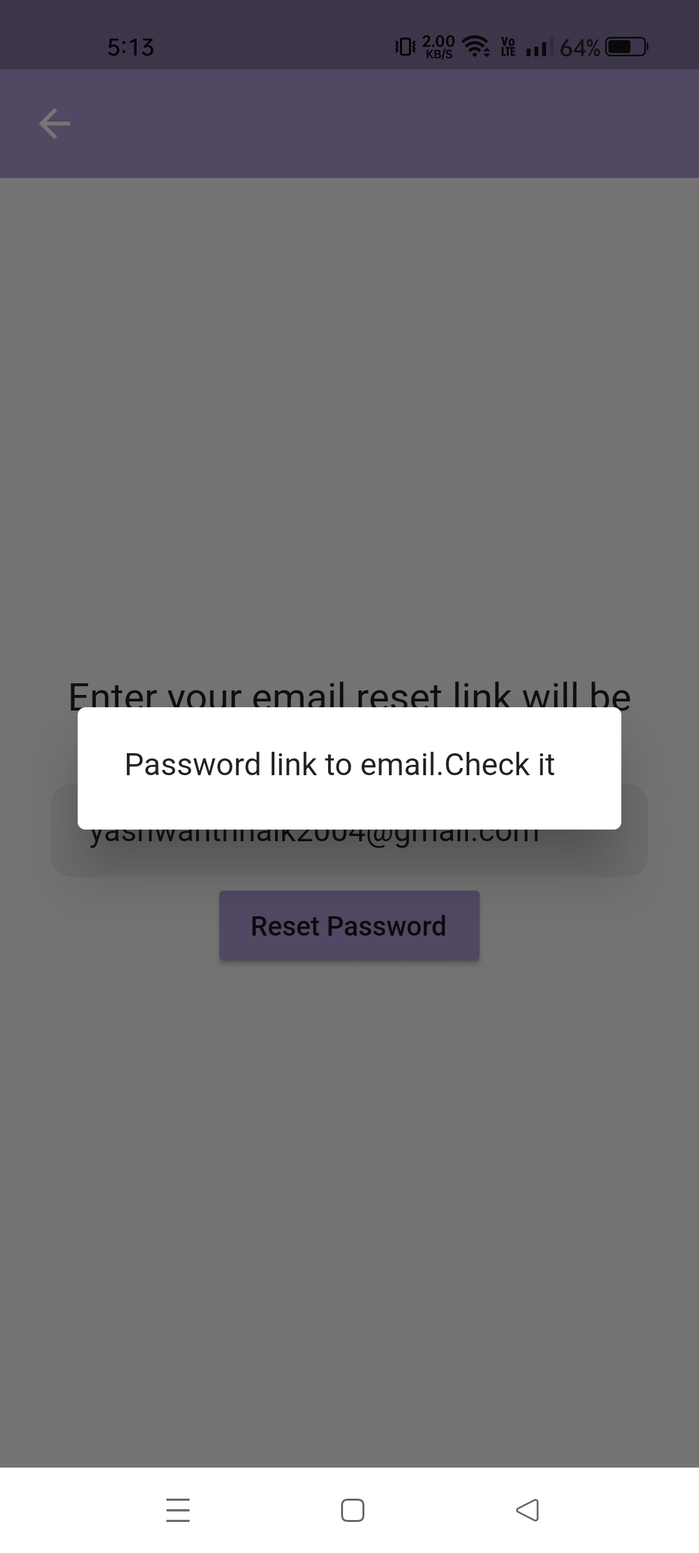
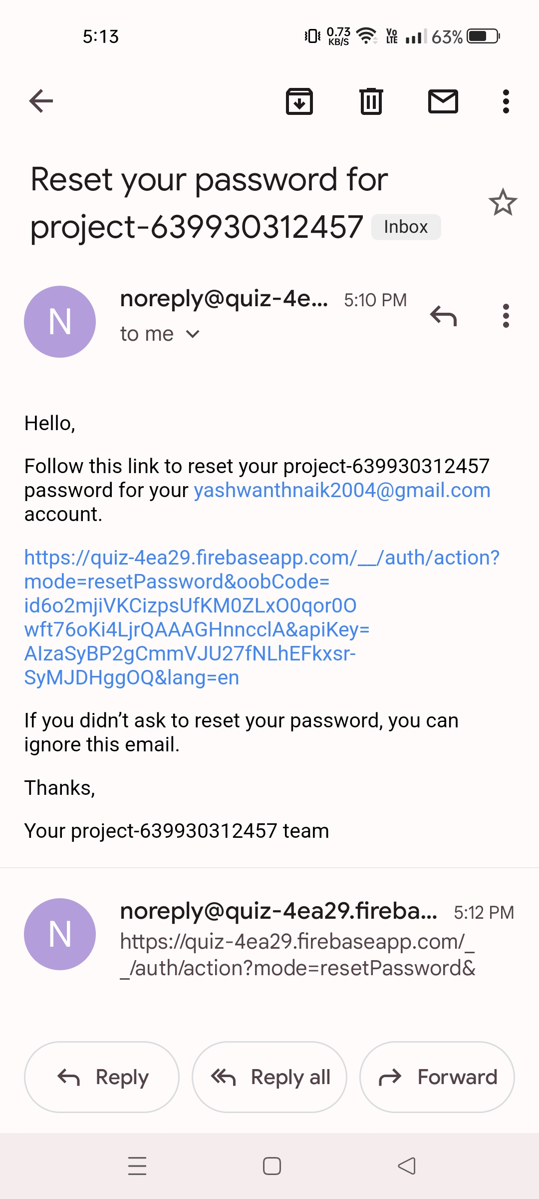
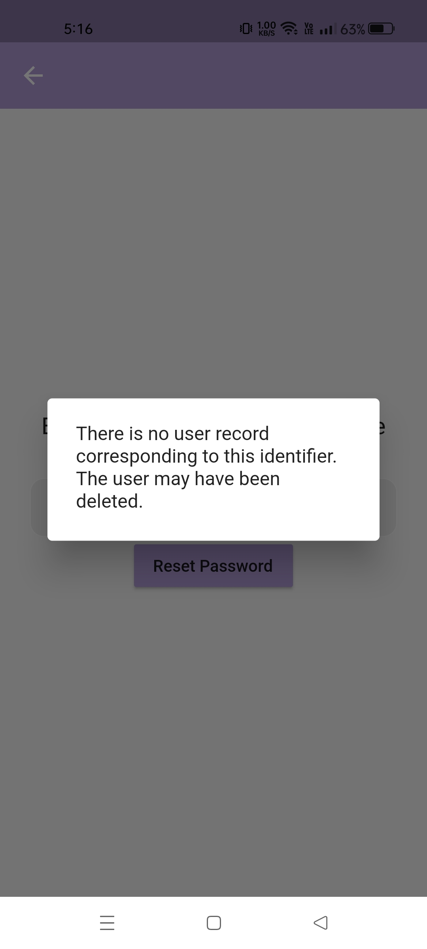
FORGOT PASSWORD ?
Reset link
VALID
INVALID

Slide 6
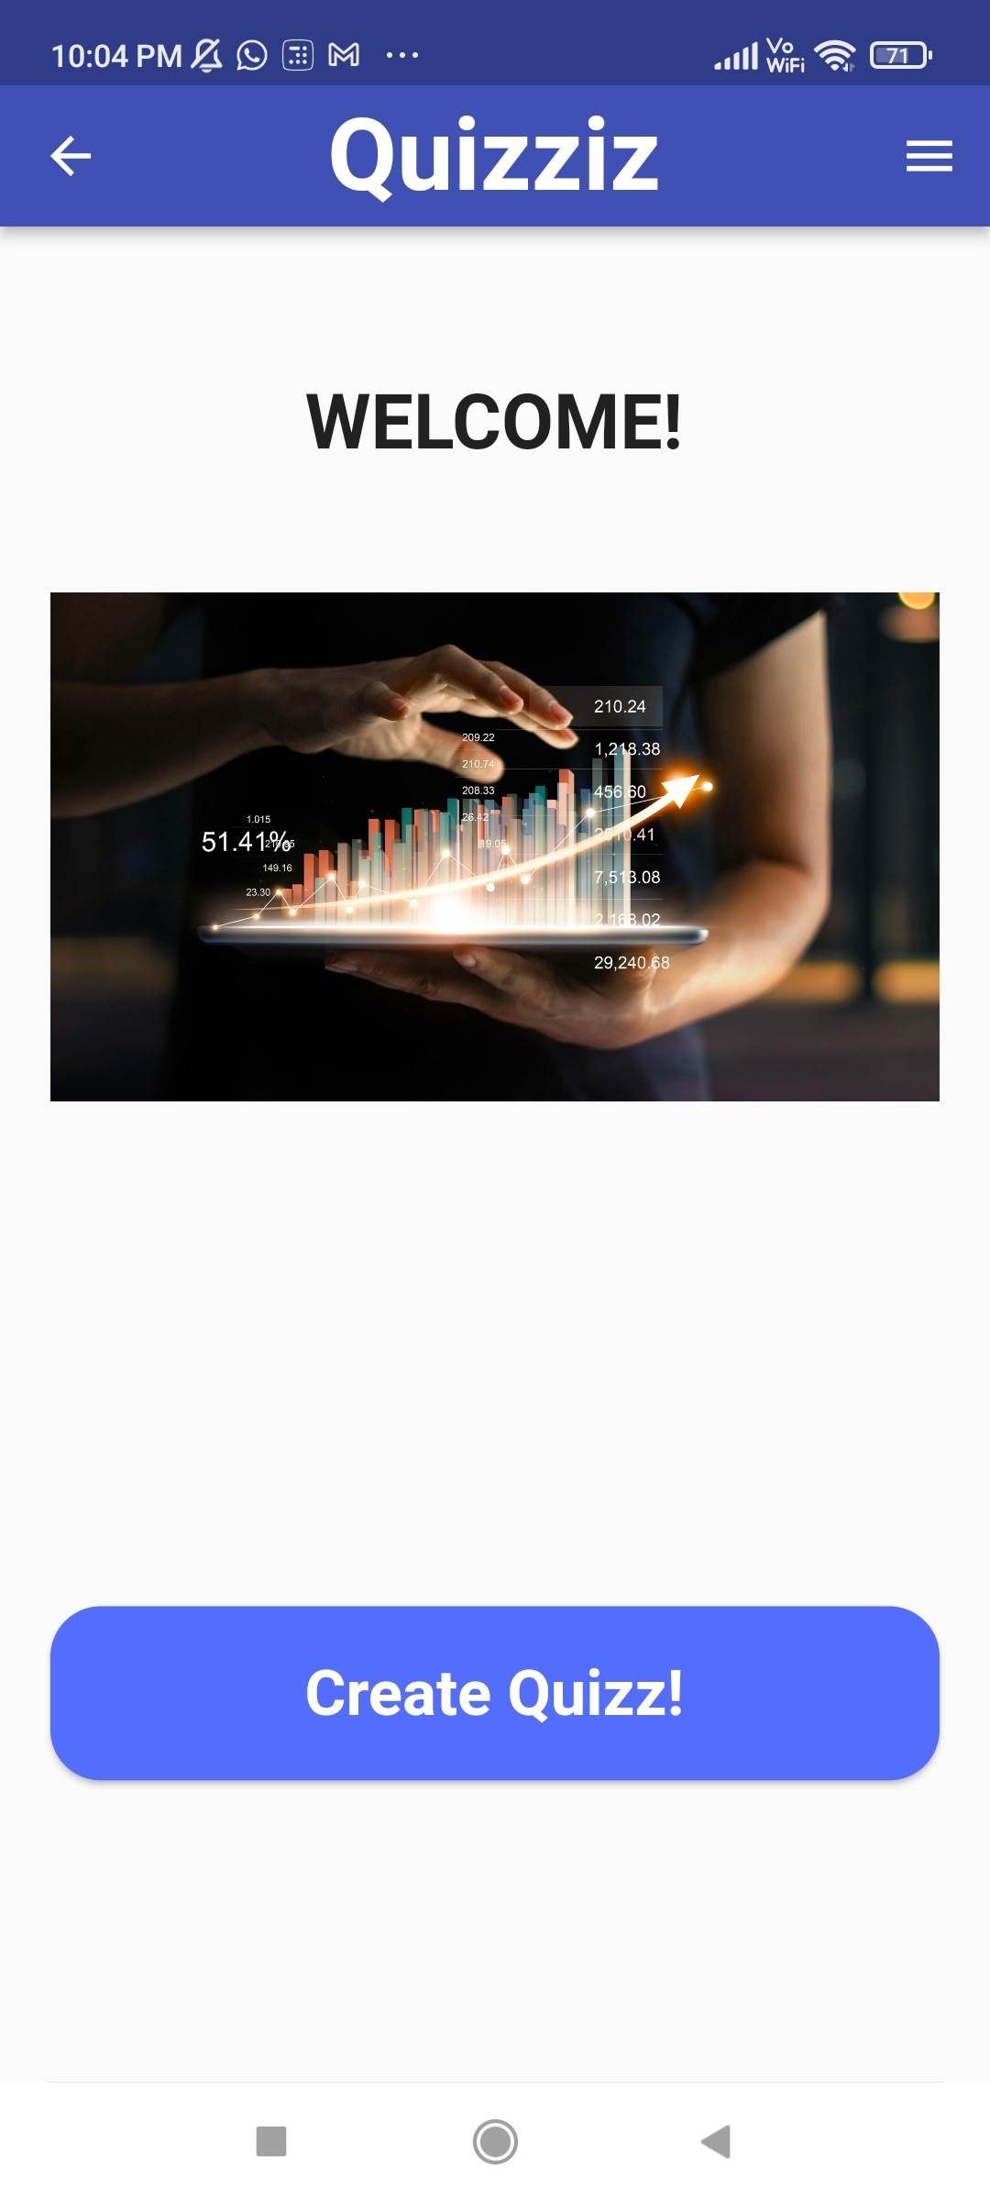
TEACHER HOME PAGE
After Sign-In the Teacher is directed to the Teacher-home page.
Home page has 2 options
Check profile (Drawer at top right corner
CREATE QUIZ

Slide 7
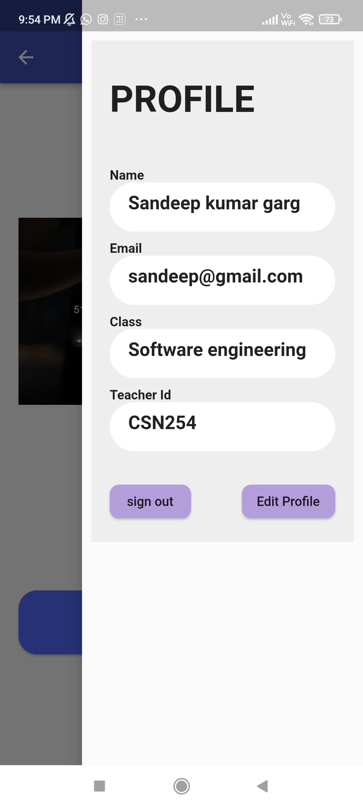
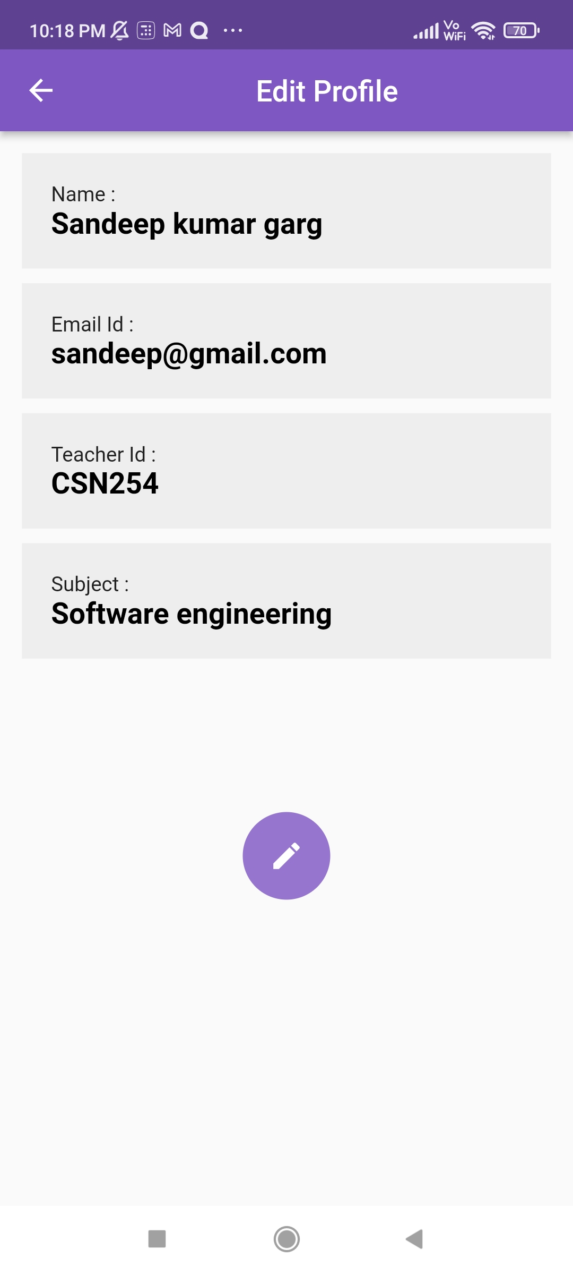
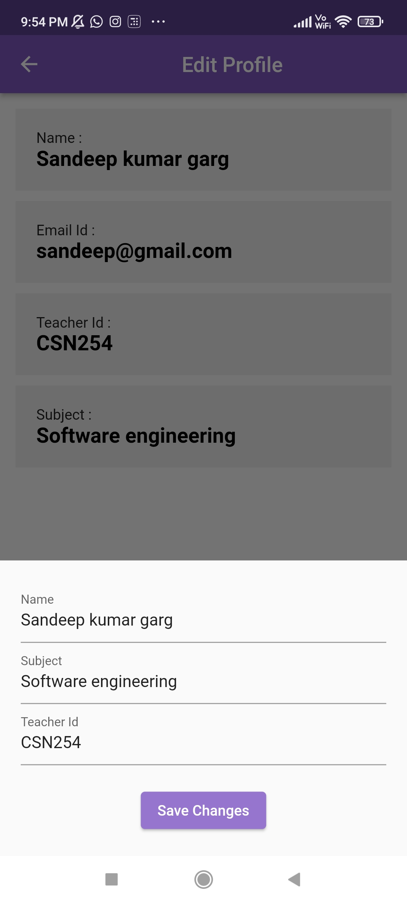
1. TEACHER PROFILE

Slide 8
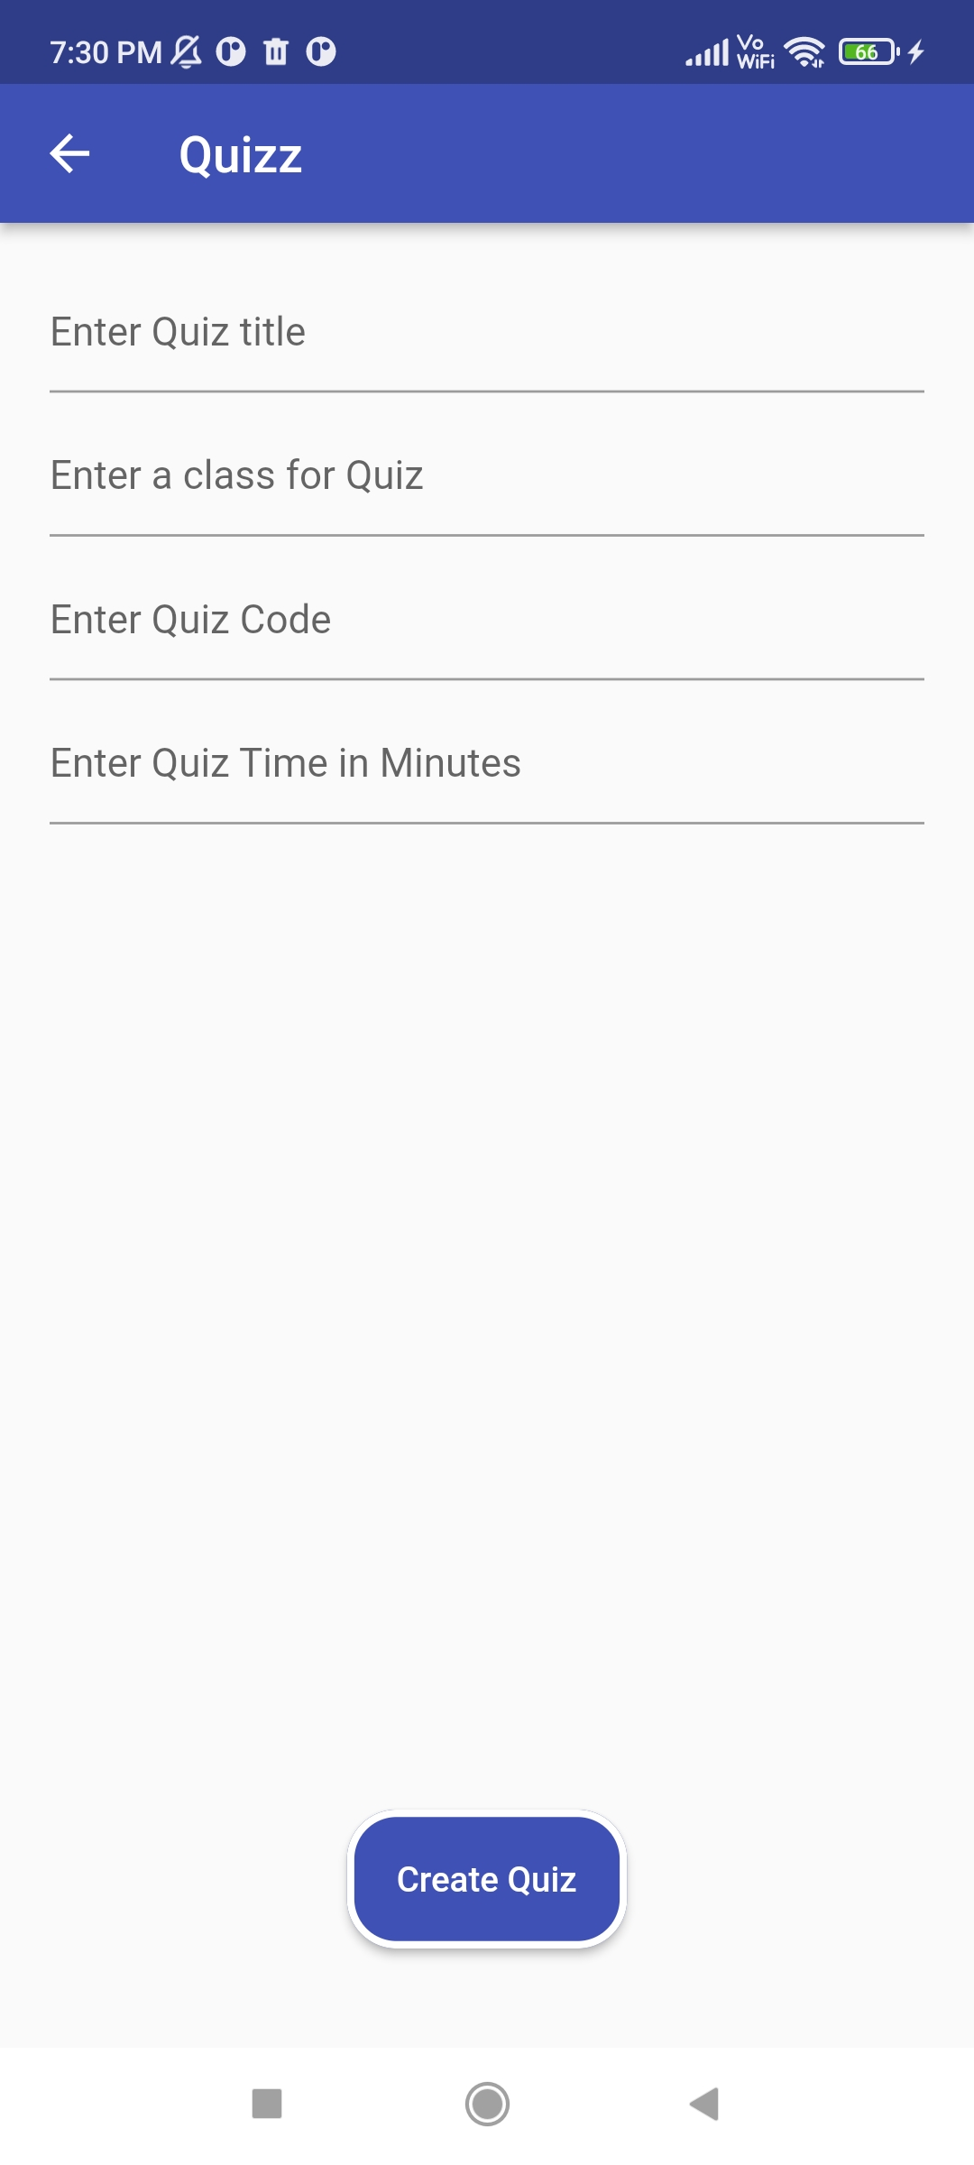
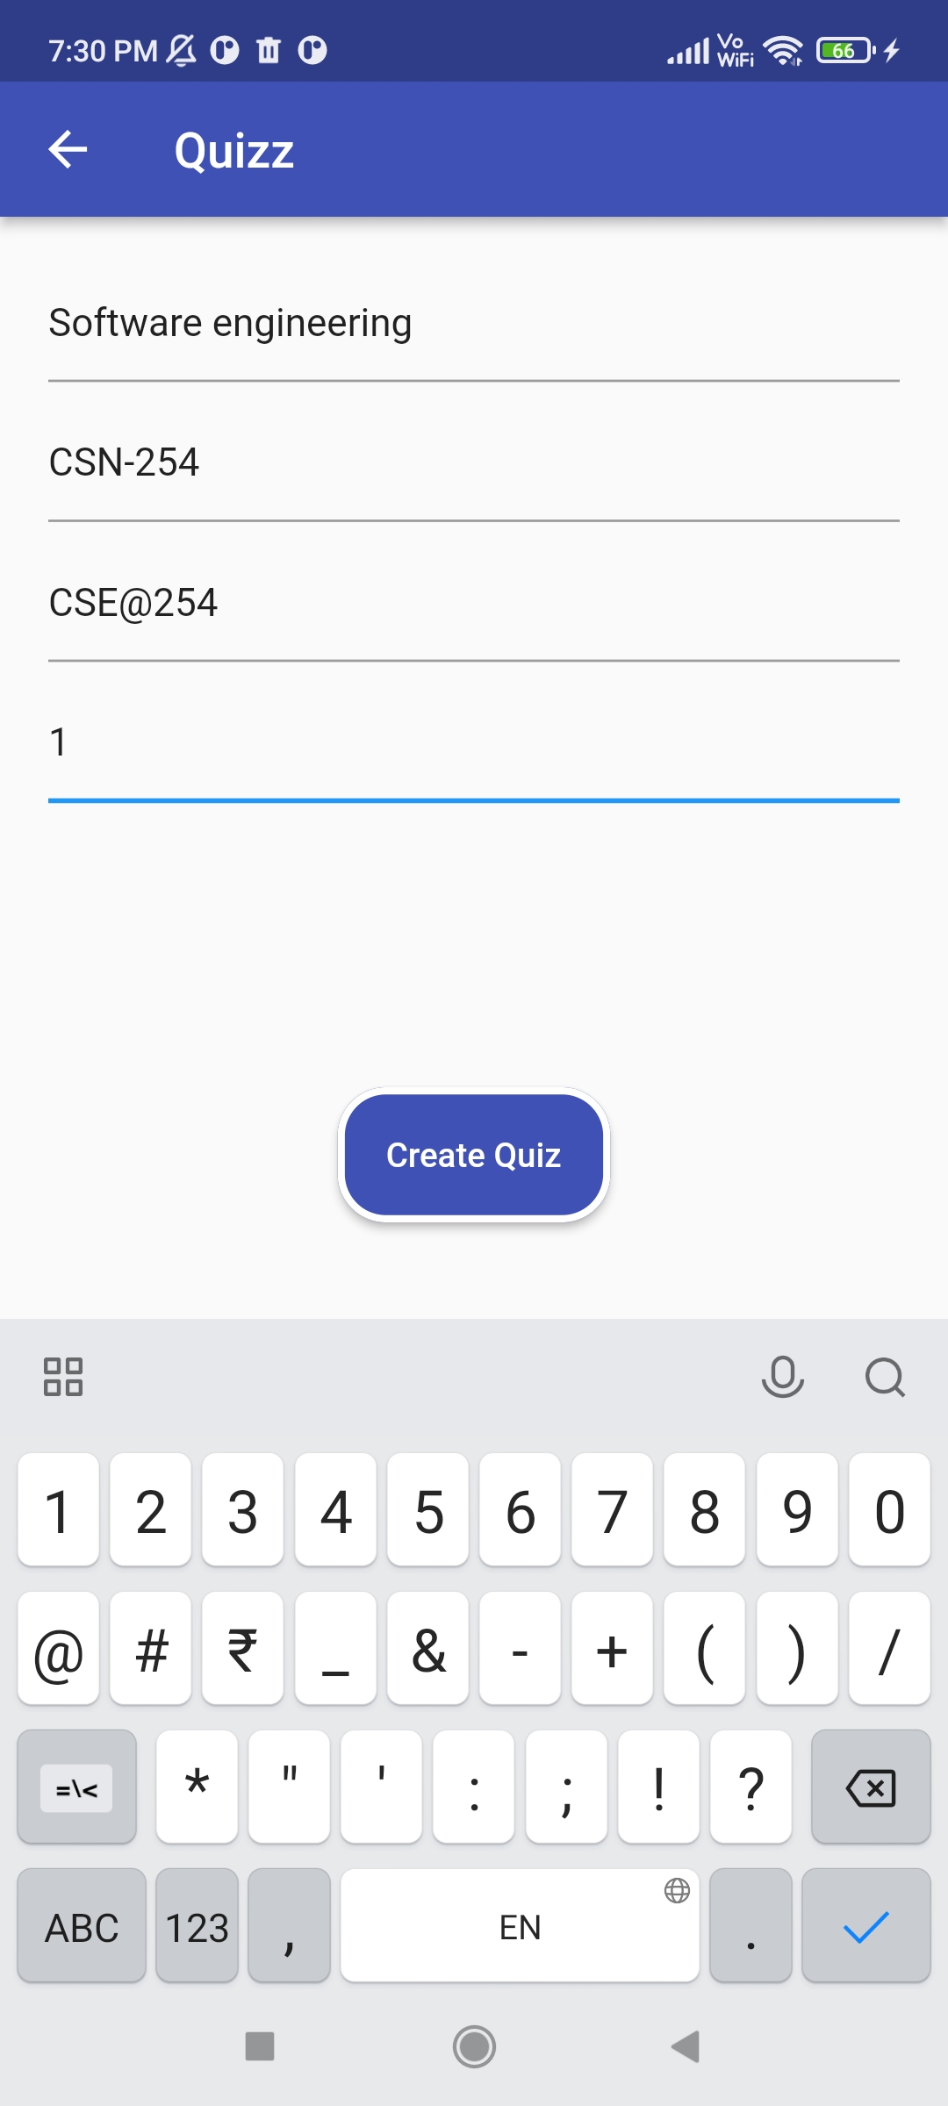
2. CREATE QUIZ

Slide 9
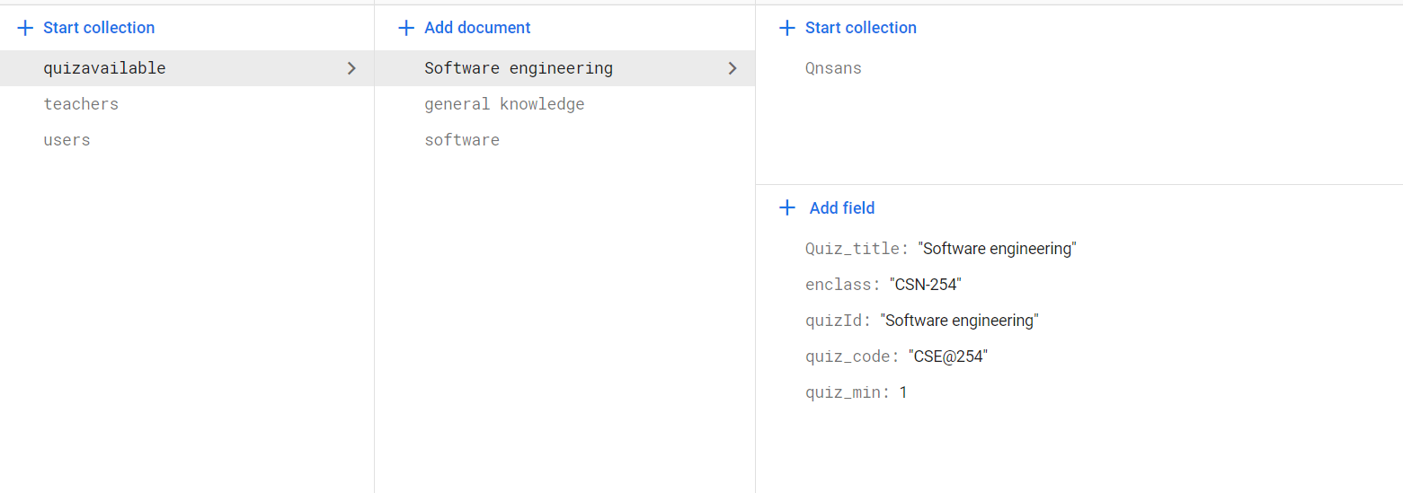
DataBase storing

Slide 10
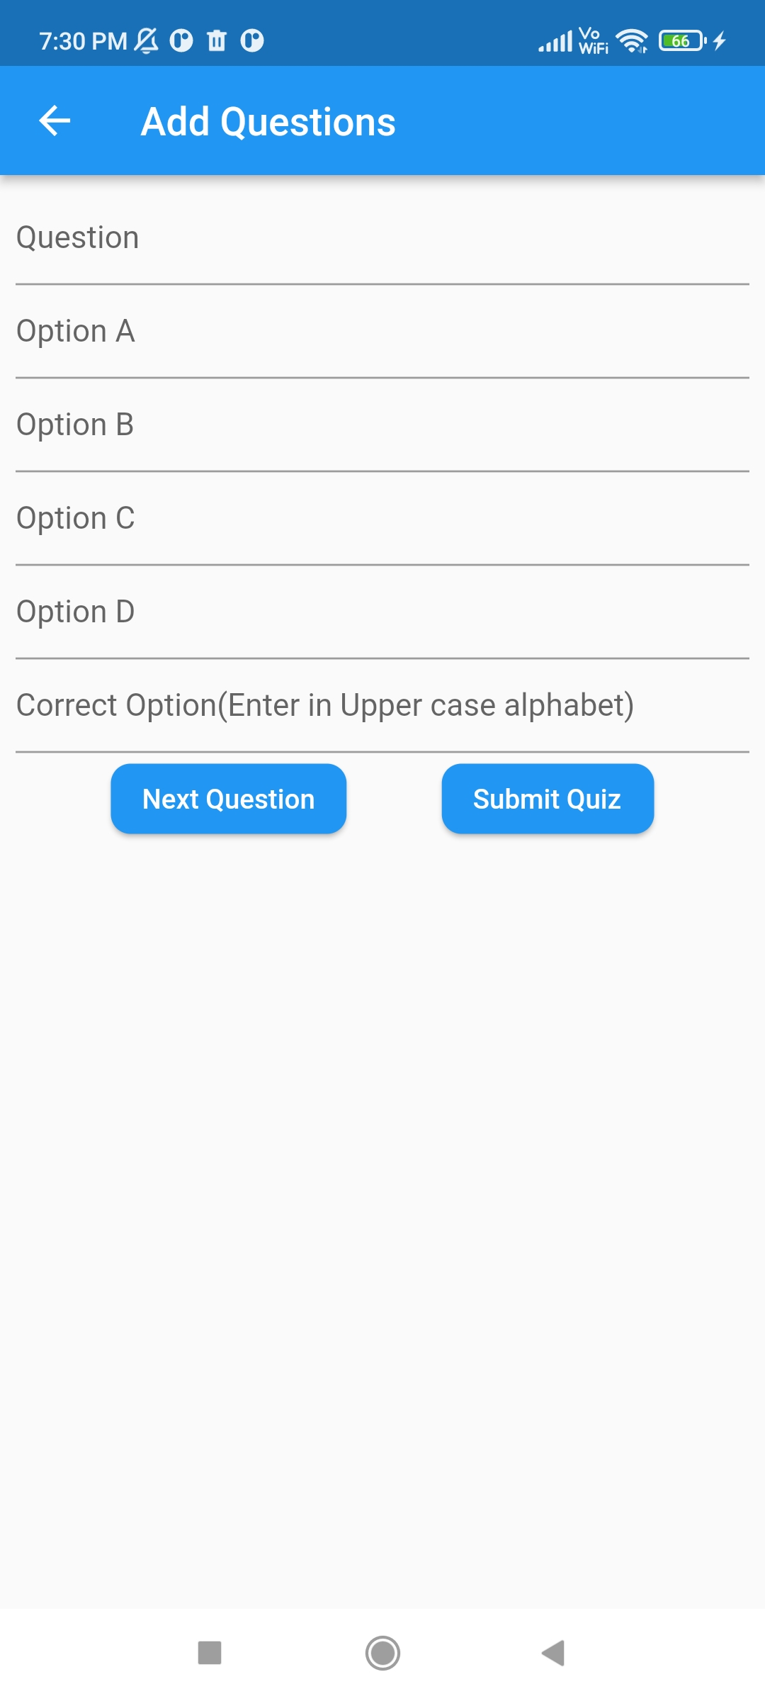
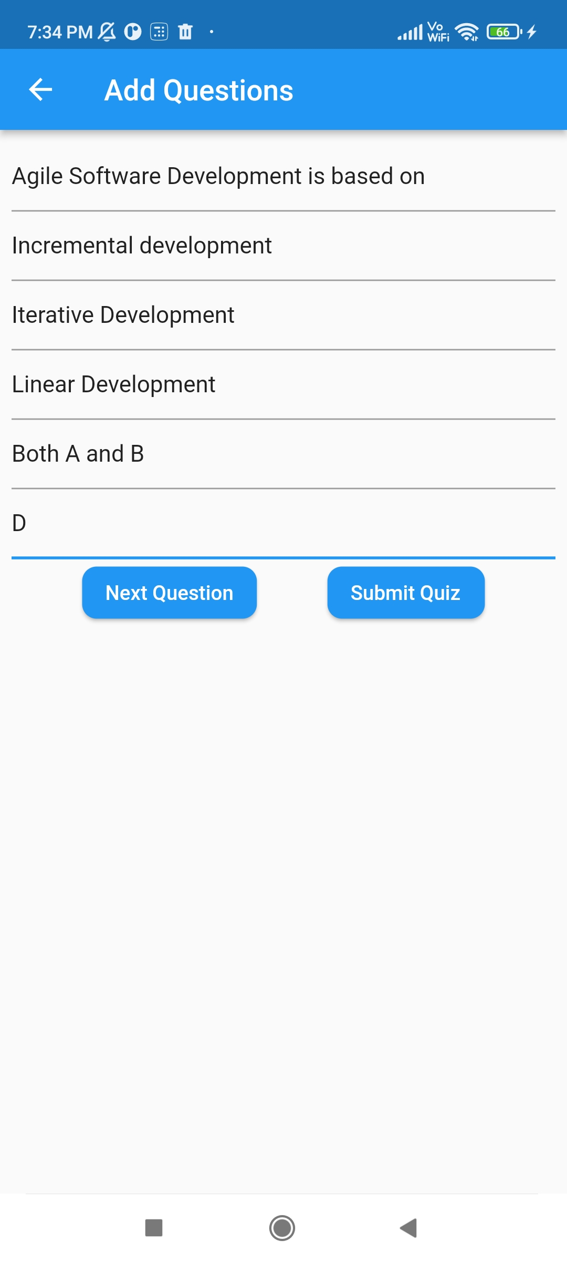
SUBMIT
UPDATES QUIZ IN STUDENTS QUIZ PAGE

Slide 11
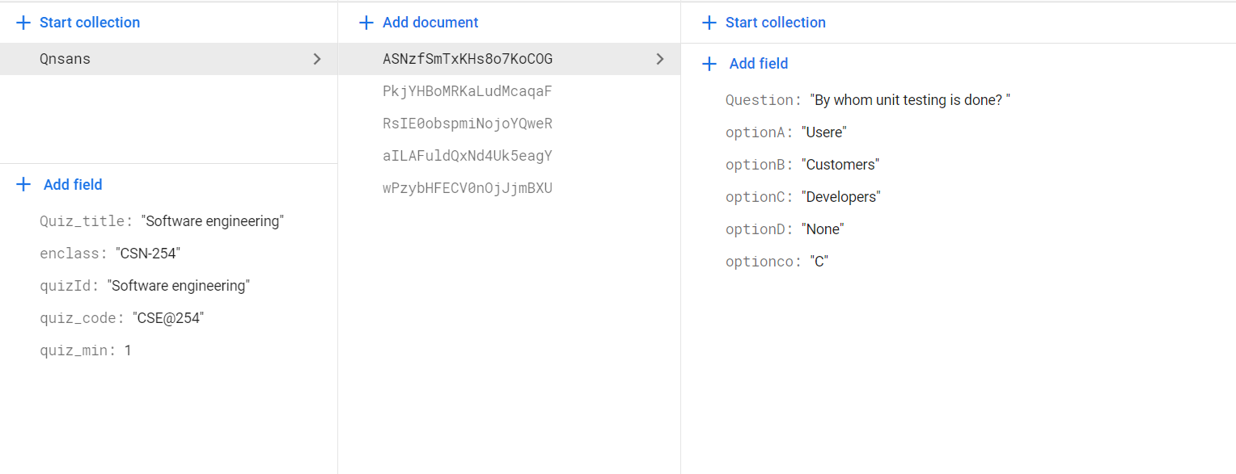

Slide 12

STUDENT

Slide 13
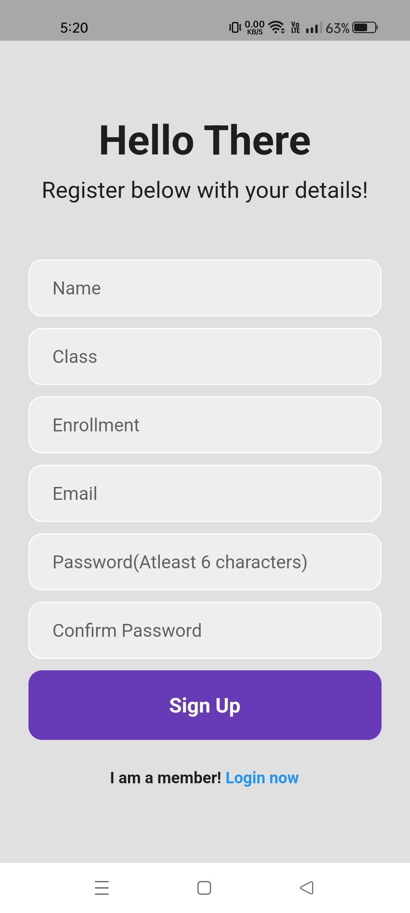
STUDENT SIGN-IN PAGE
In the SIGN-IN PAGE student need to enter his/her registered details.
If not registered then he/she needs to click the “Register now” button which takes them to the Register page where they have to enter their details and click Sign-up.
NOTE: If student enter non-registered mail then we get this error message.

Slide 14
FORGOT PASSWORD ?
Reset link
VALID
INVALID

Slide 15
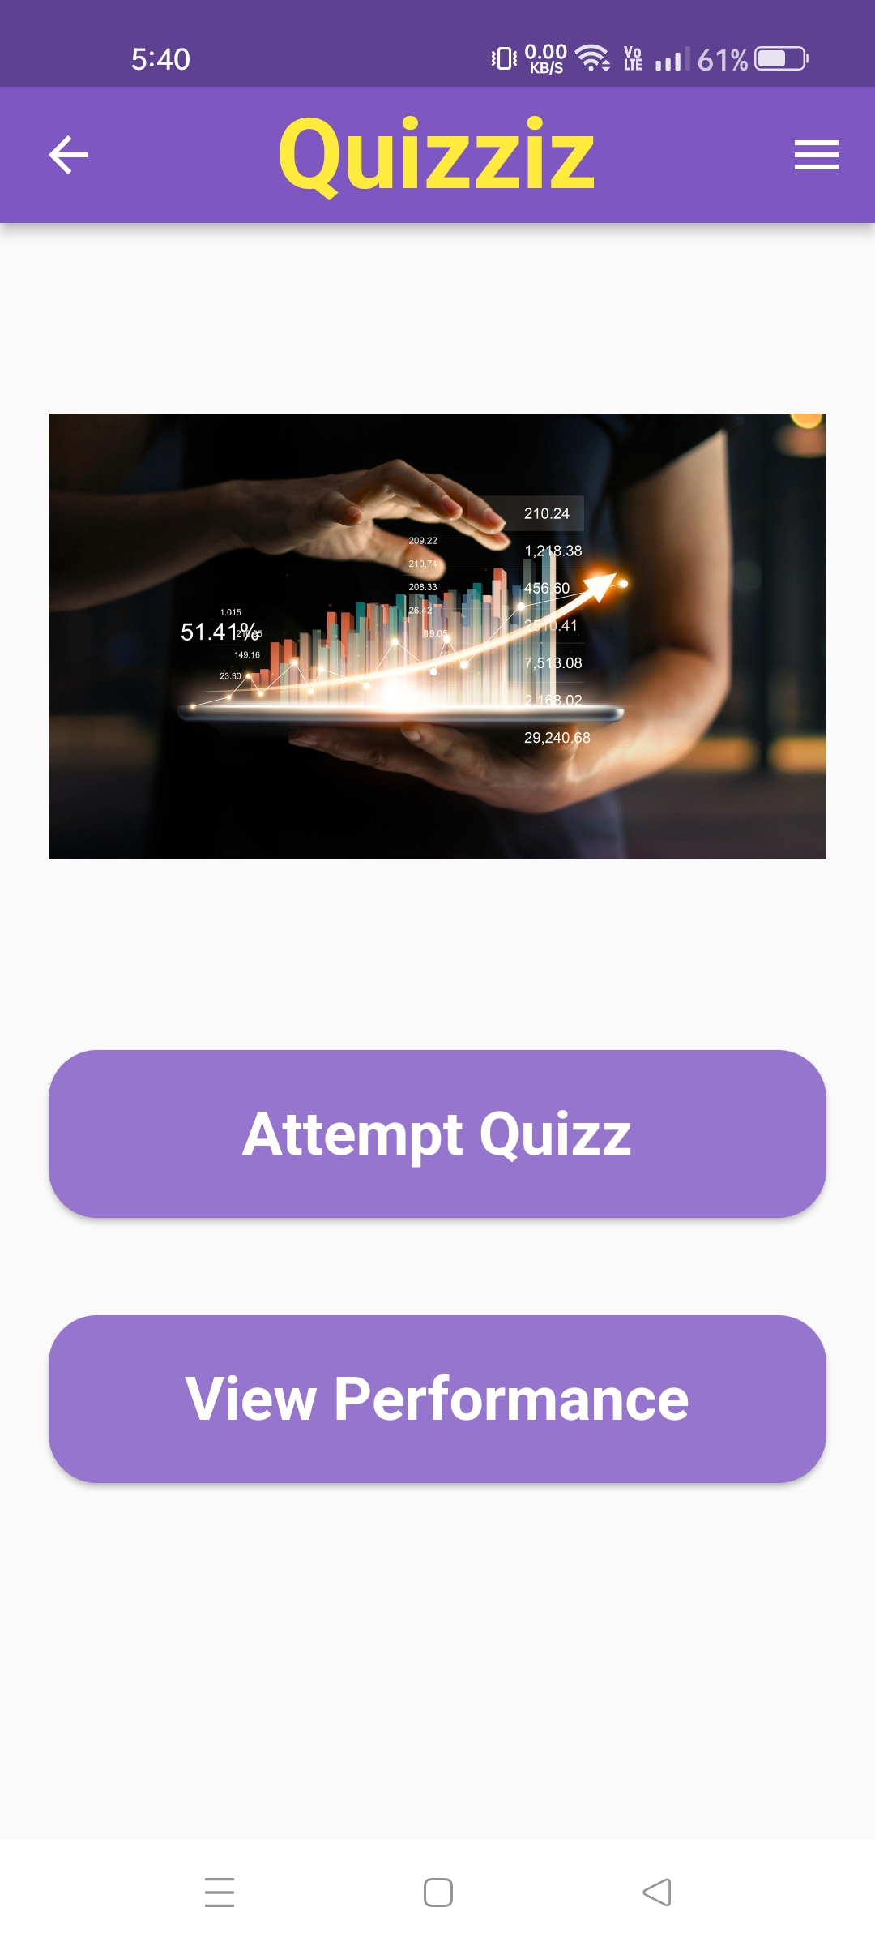
STUDENT HOME PAGE
After Sign-In the student is directed to the home page.
Home page has 3 options
Check profile (Drawer at top right corner
Attempt Quiz
View performance (to check scores of earlier quizzes)

Slide 16
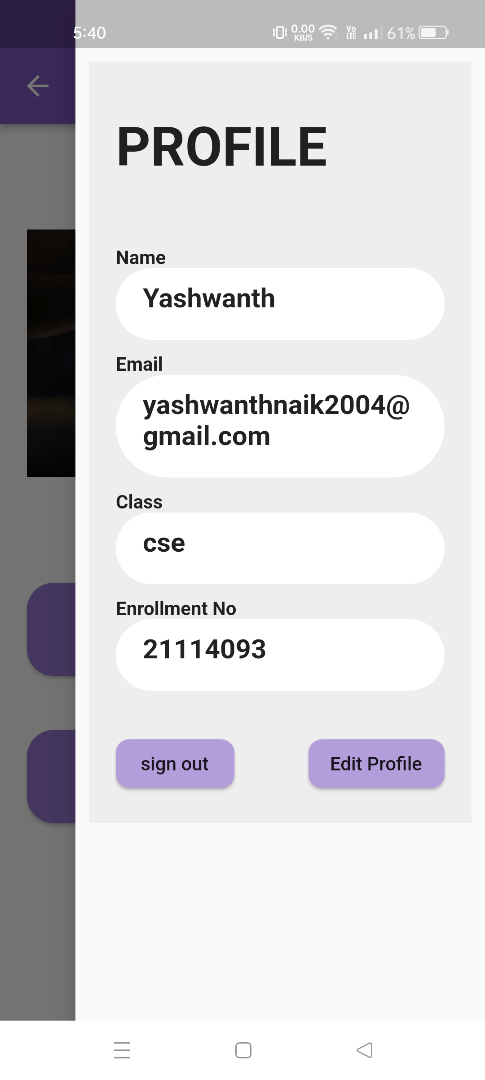
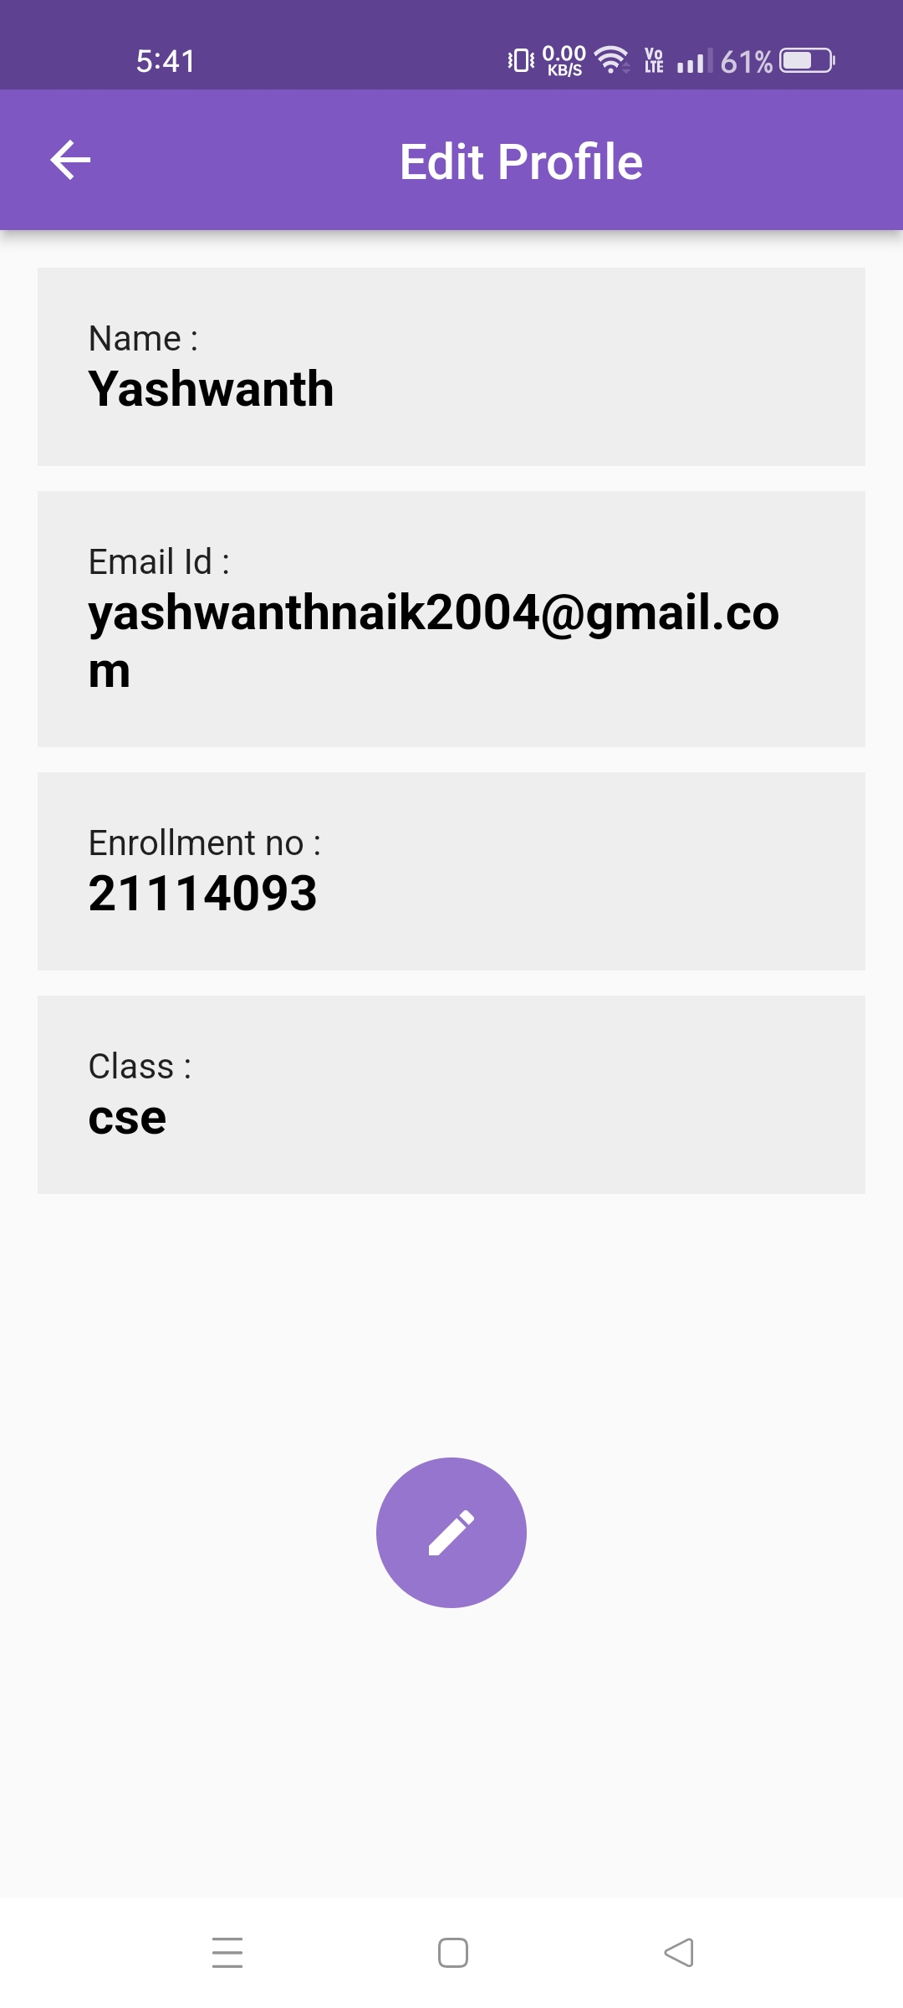
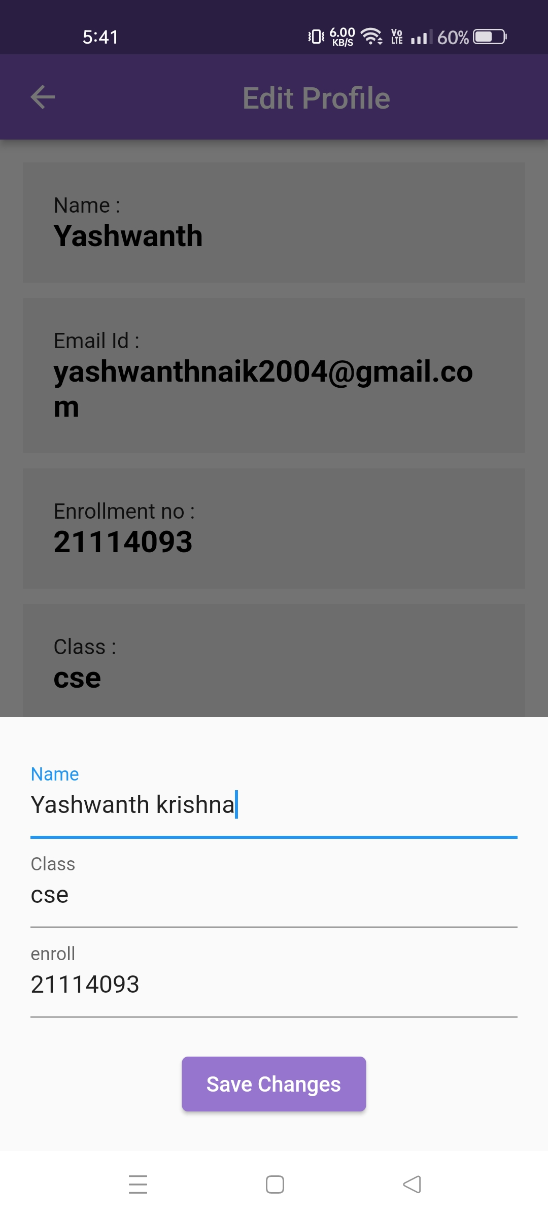
1.STUDENT PROFILE

Slide 17
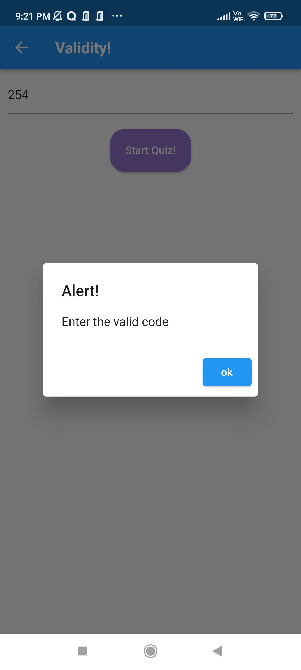
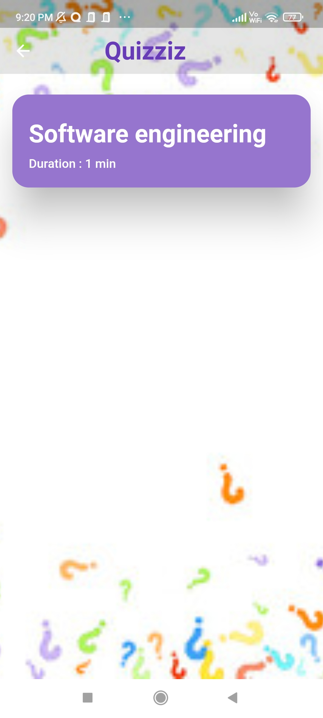
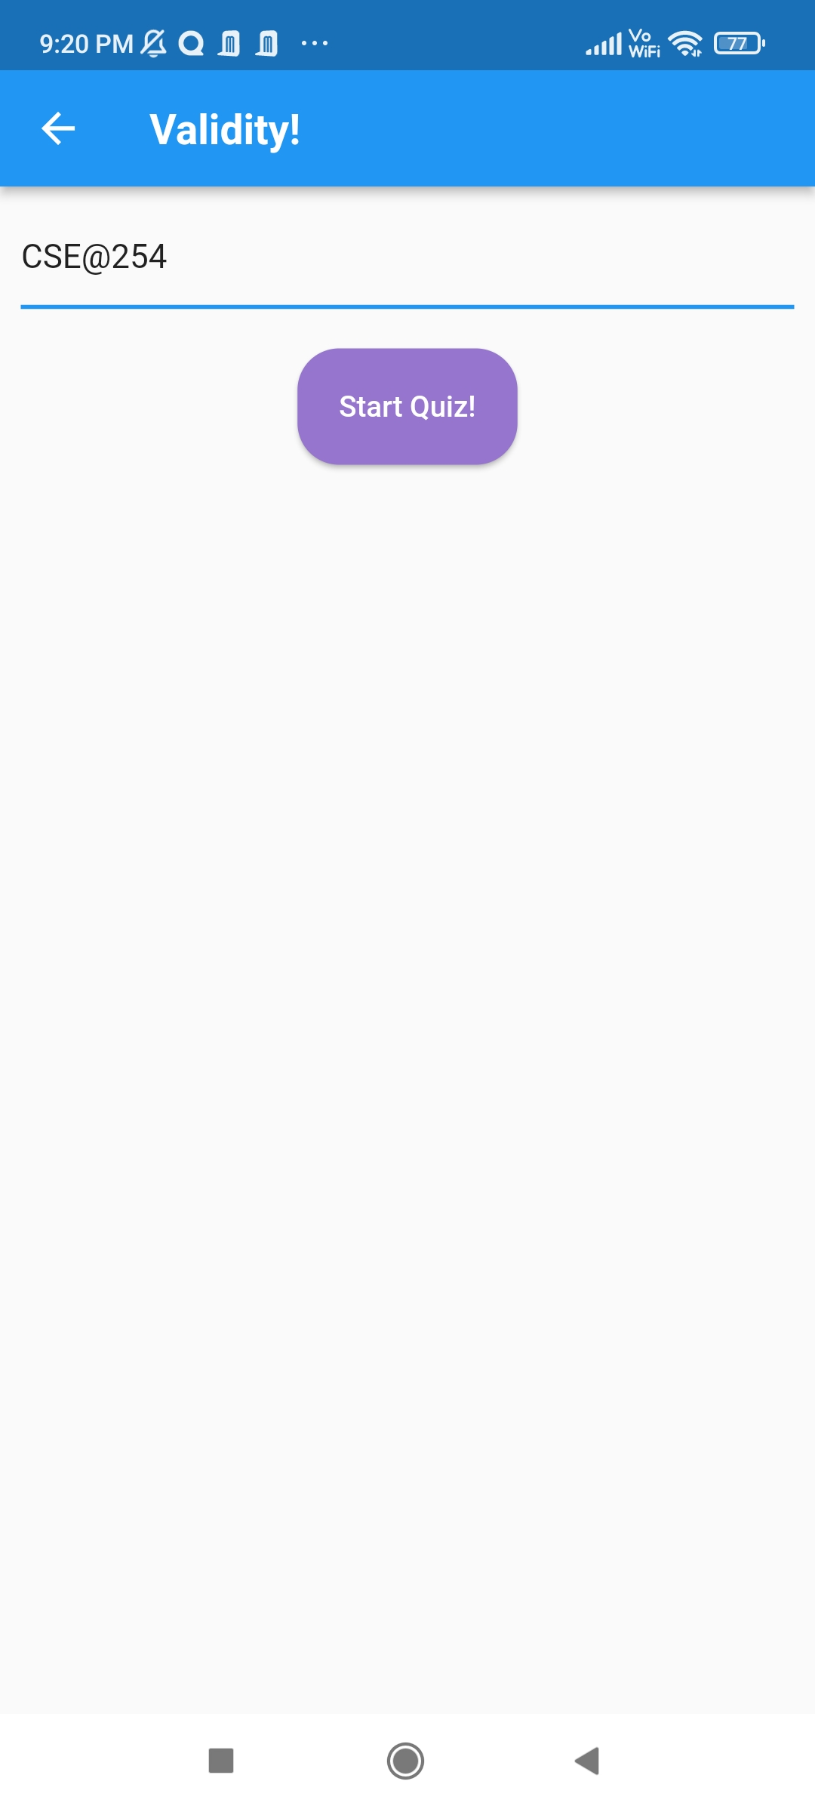
2. Attempt quiz
If INVALID CODE
IF VALID CODE
GOES TO NEXT PAGE

Slide 18
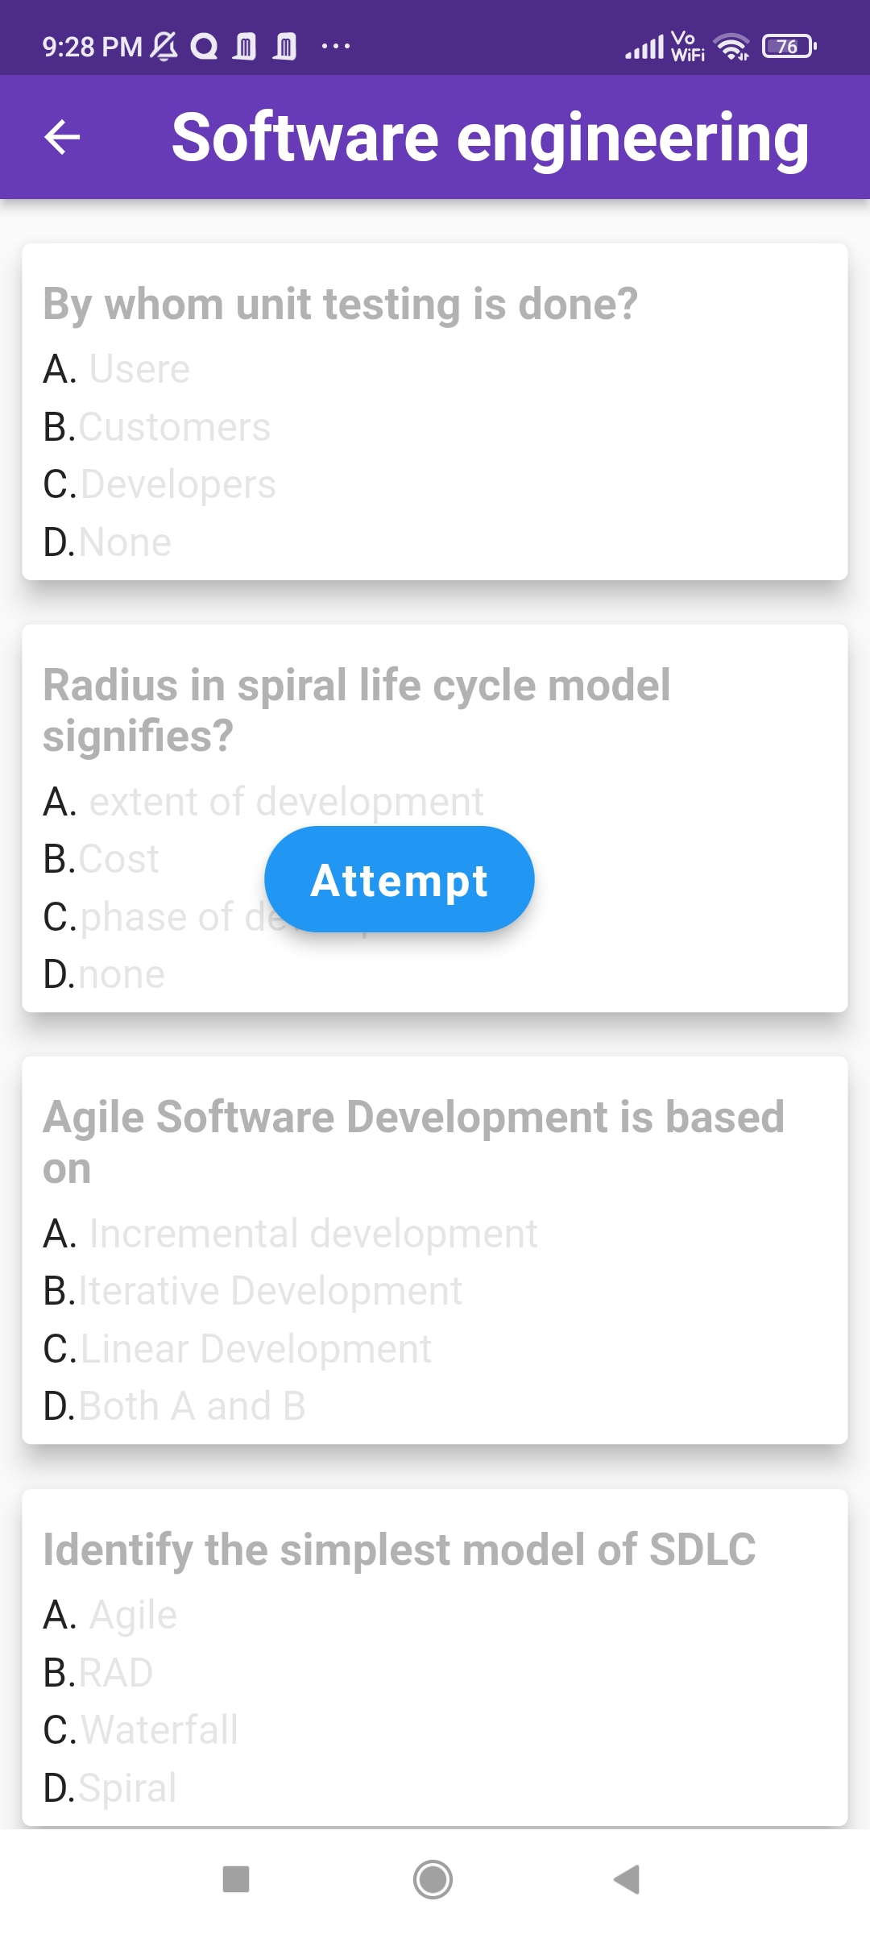
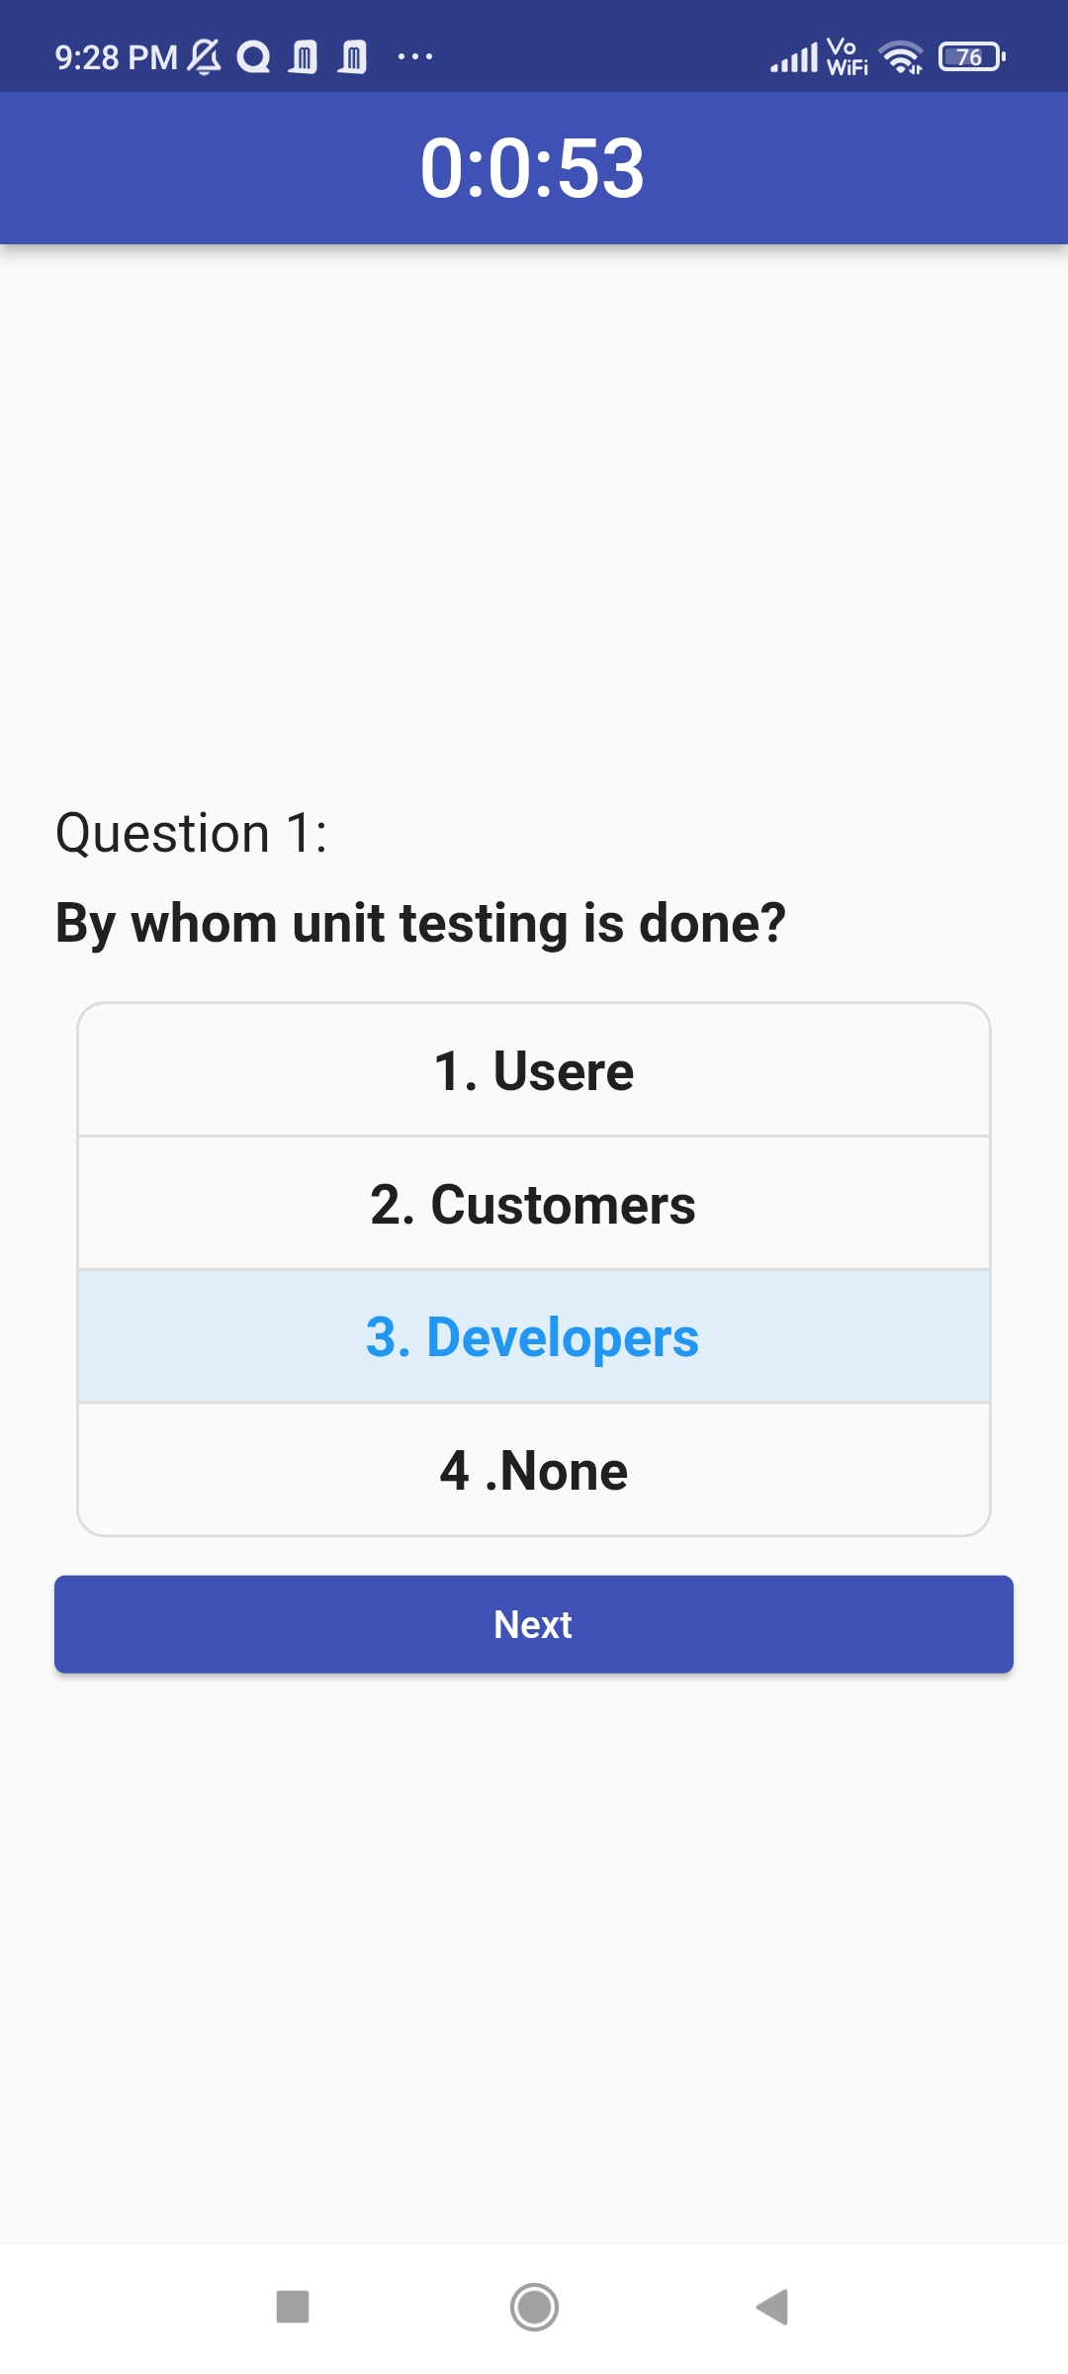
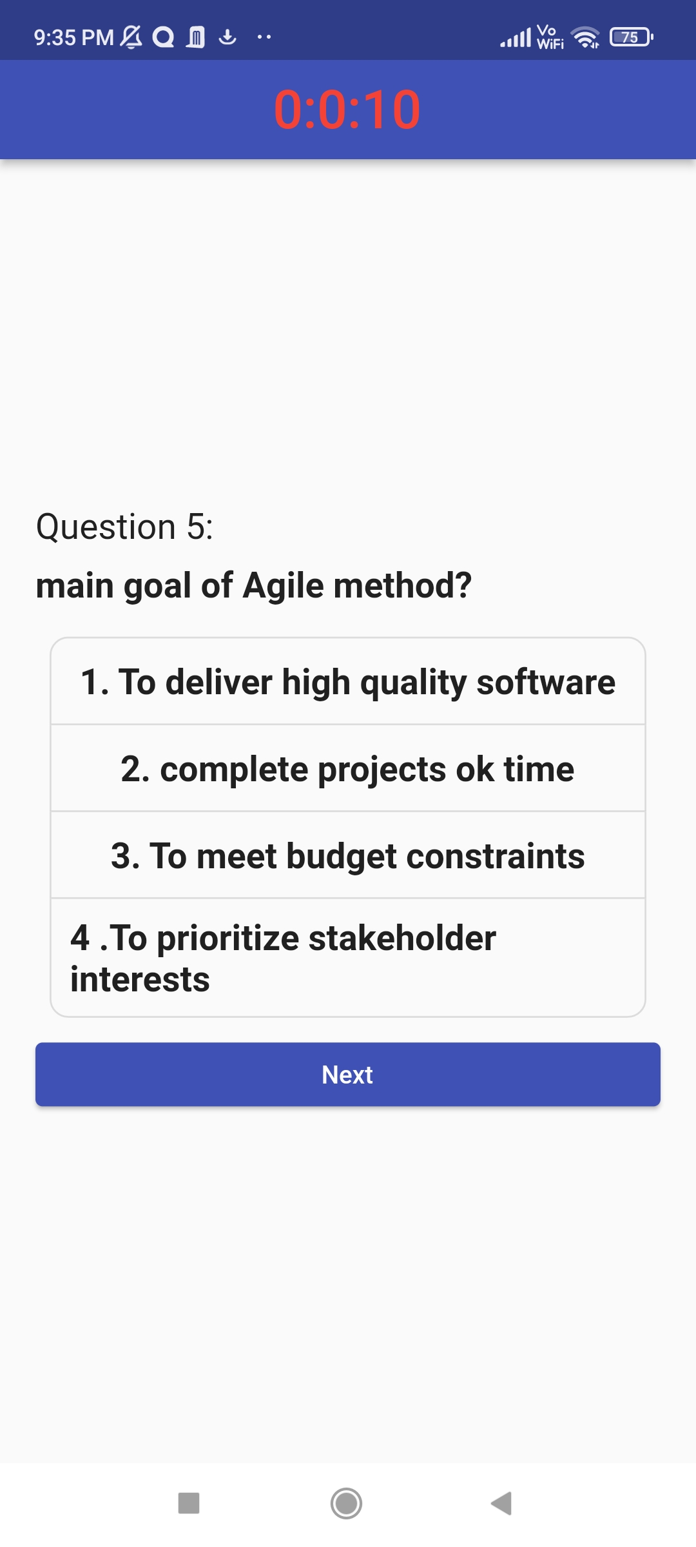


Slide 19
T I M E R

Slide 20
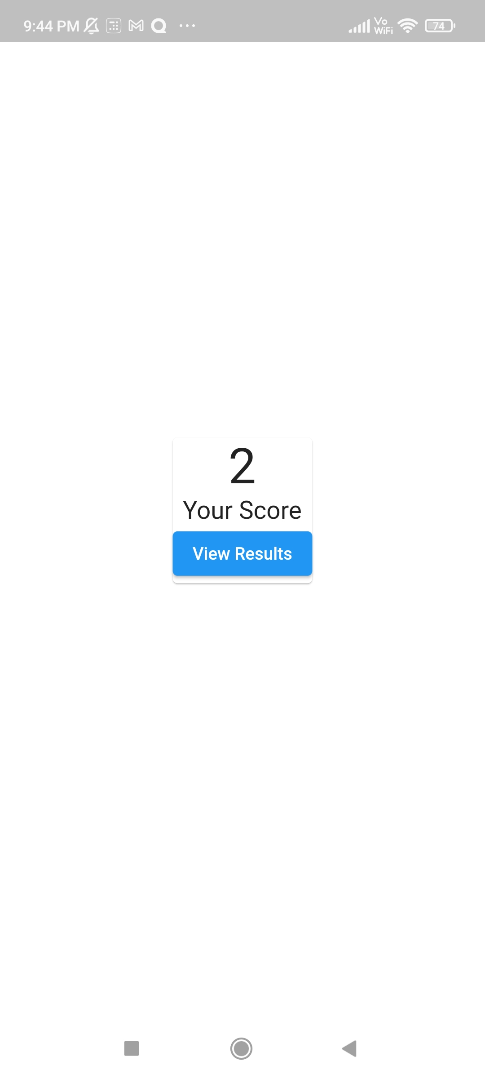
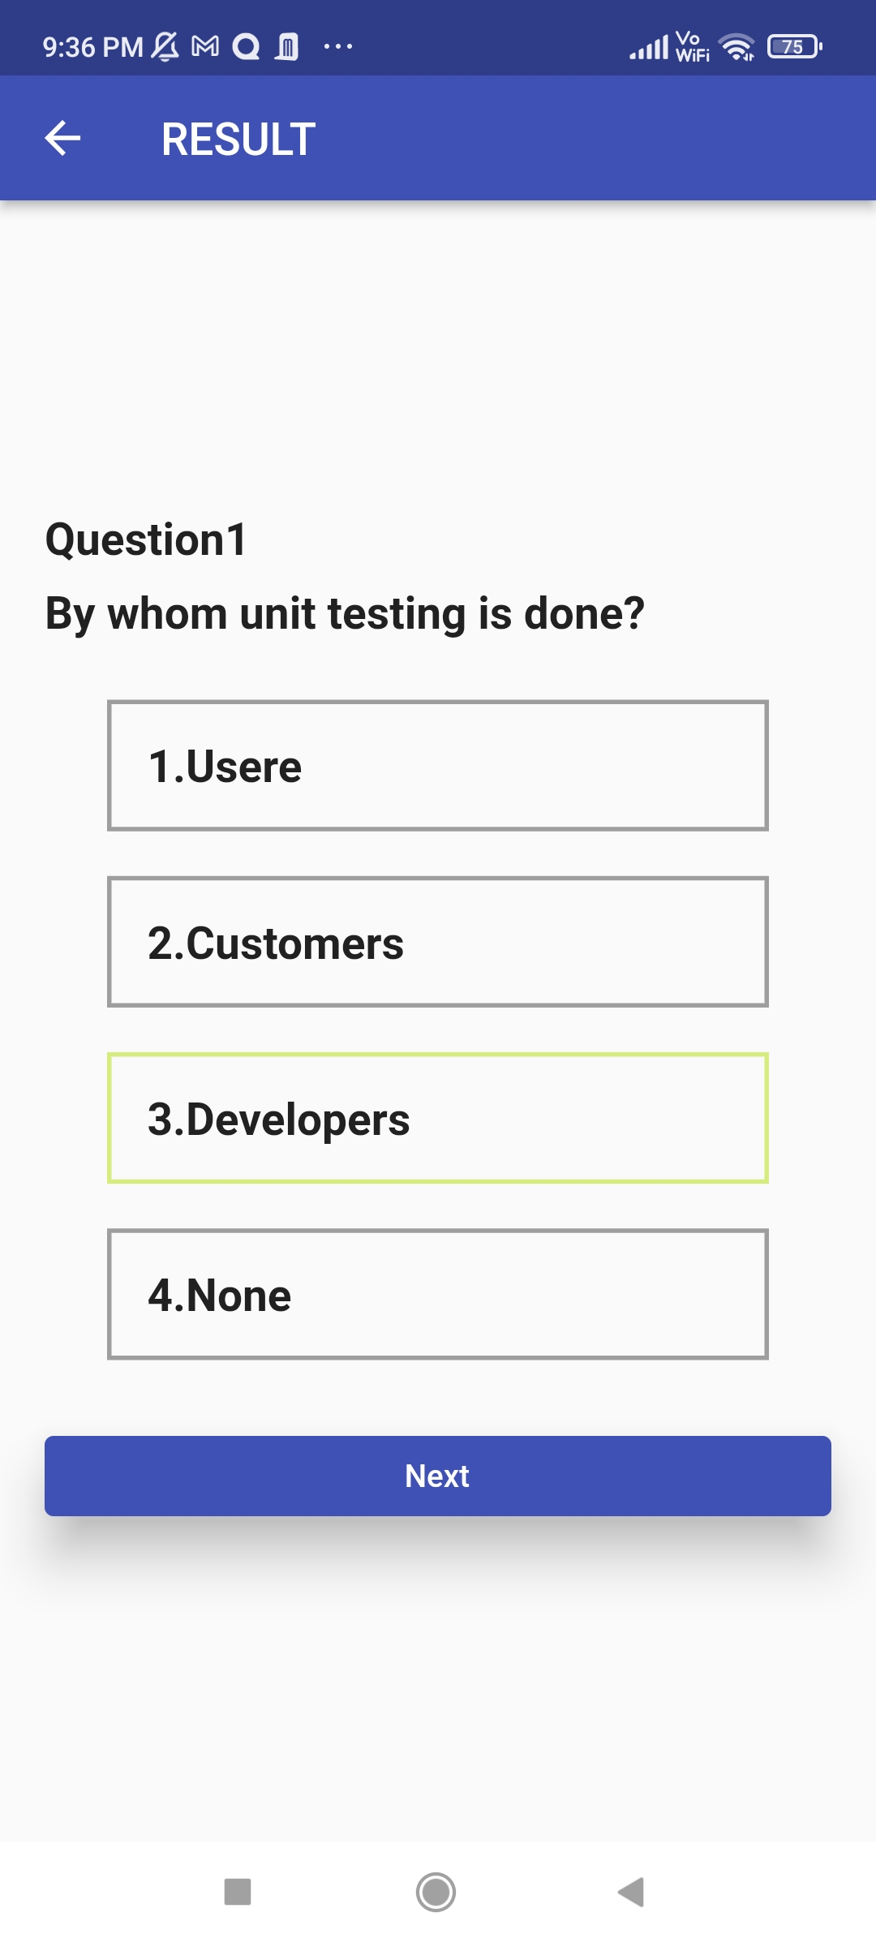
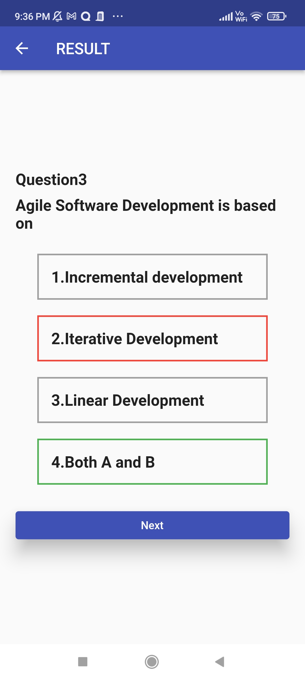
RESULTS AND RESPONCES

Slide 21
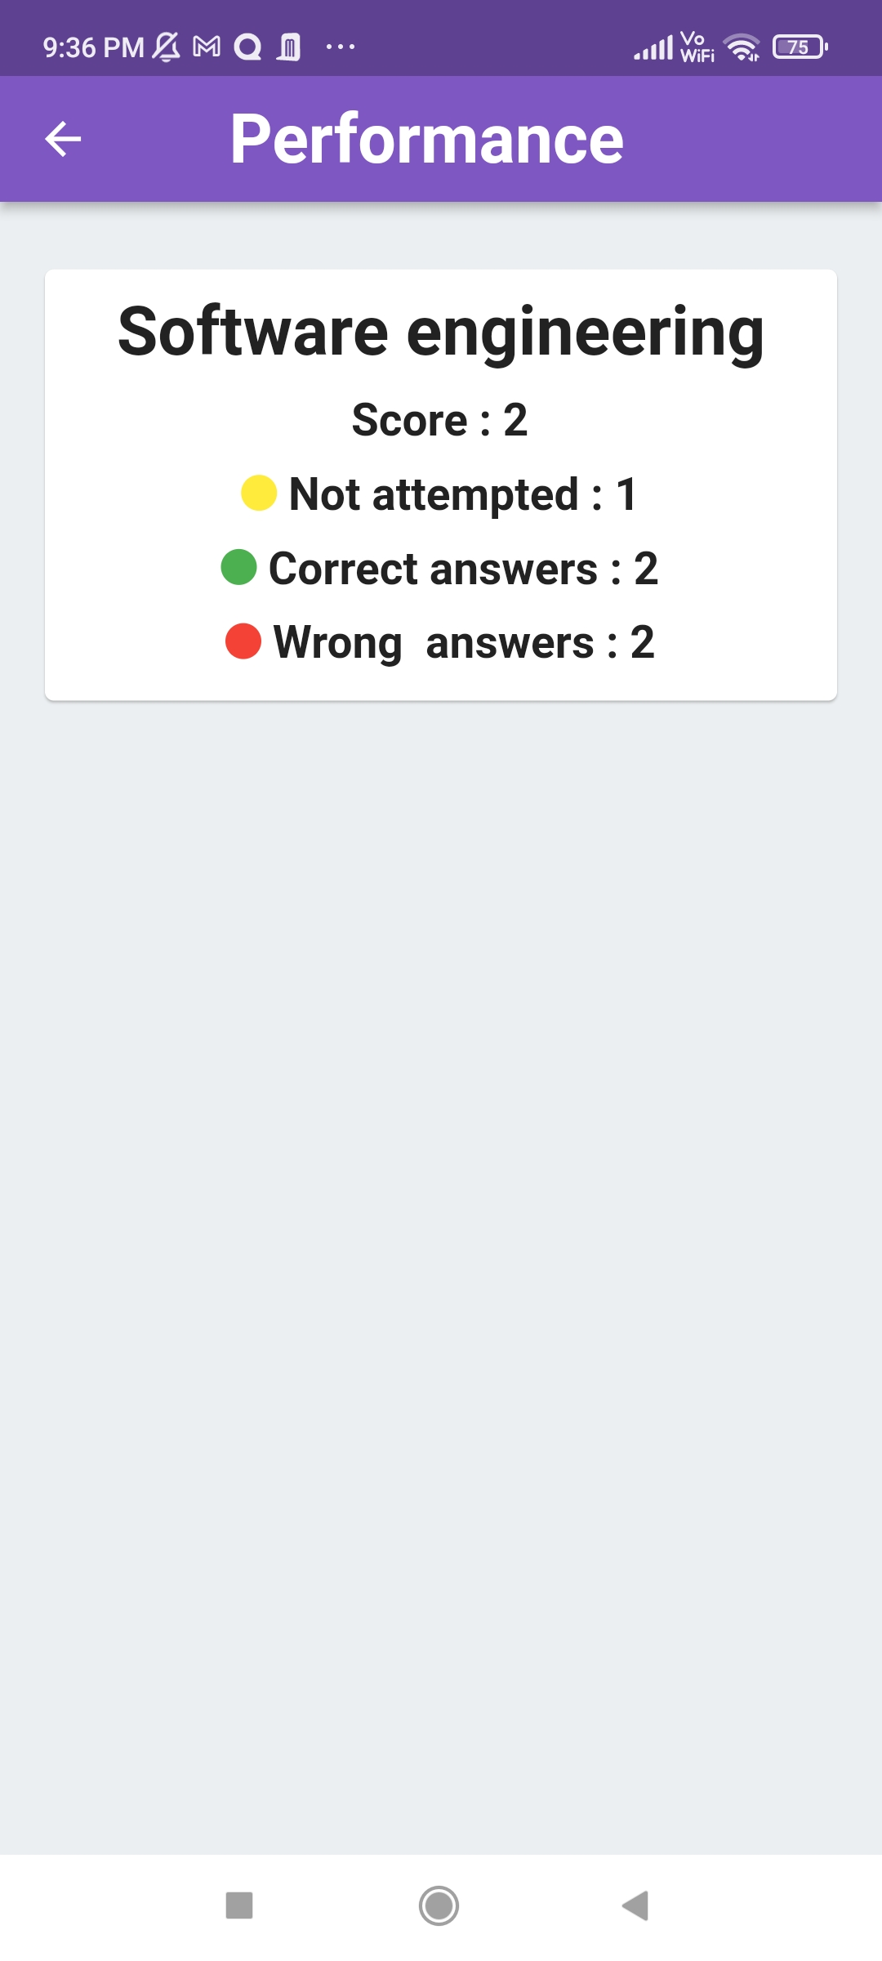
3. VIEW PERFORMANCES

Slide 22

DATABASE

Slide 23
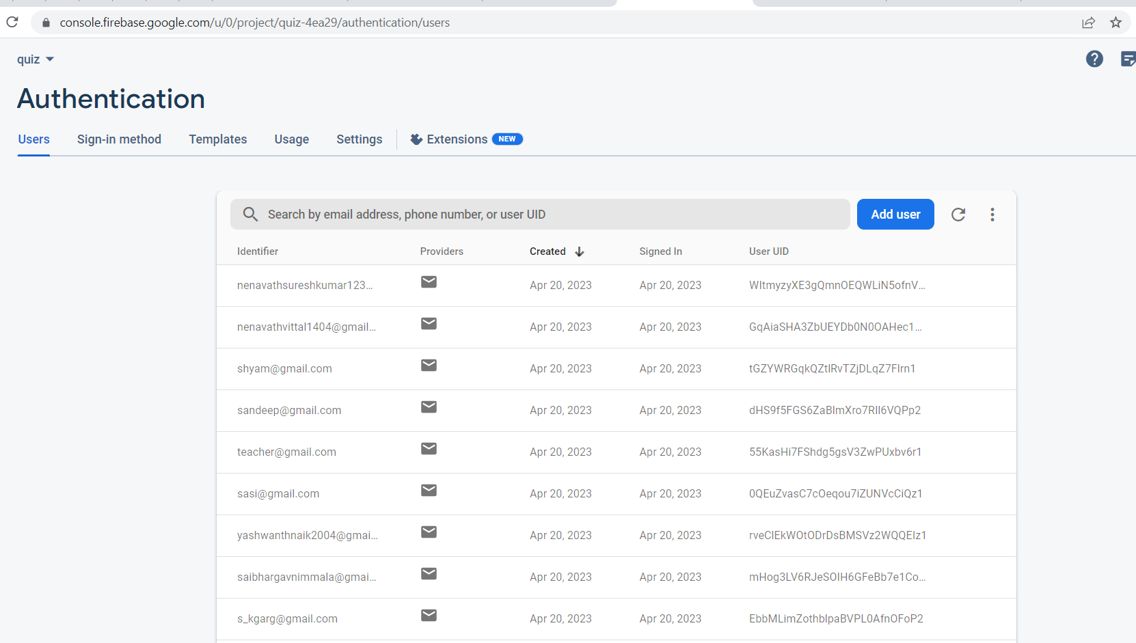
DATABASE OF AUTHENTICATION

Slide 24
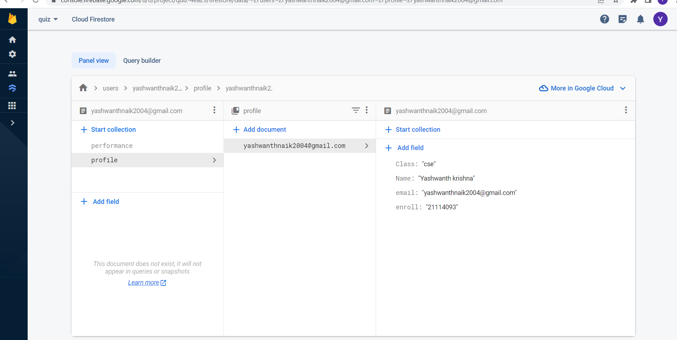
DATABASE OF student

Slide 25
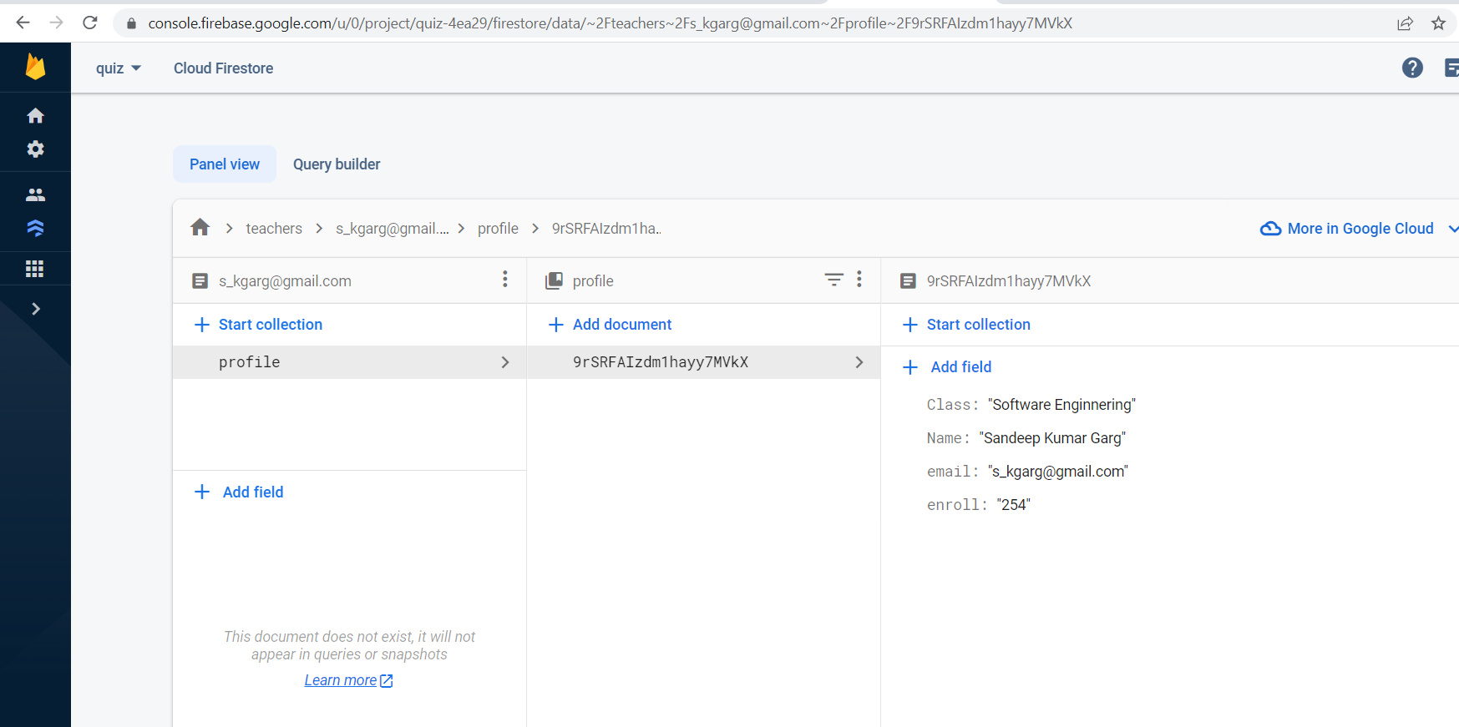
Database of teACHER

Slide 26
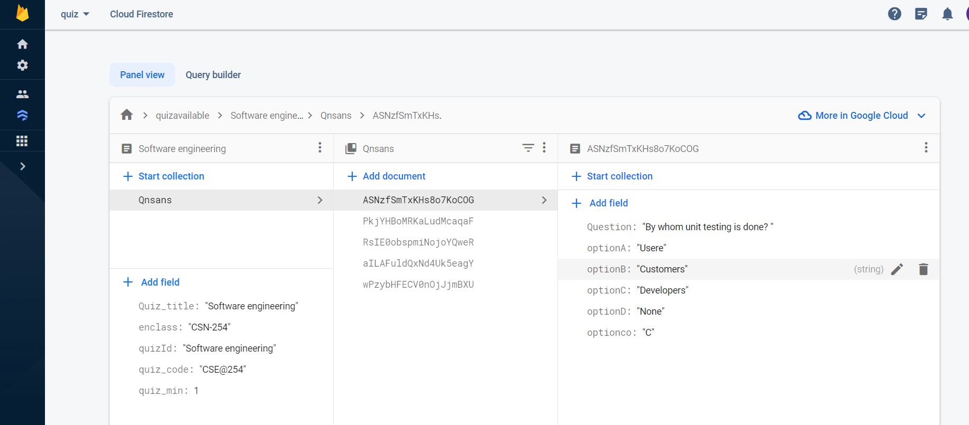
DATABASE OF QUIZS QUESTIONS

Slide 27
-BY
NENAVATH SURESH KUMAR -21114066
T.S.S. SUNDAR -21114102
NIMMALA SAI BHARGAV -21114067
SAPAVATH YASHWANTH KRISHNA -21114093
SANI SHASHI PRANEETH -21114089
KPV ANIL -21114048
THANKYOU

